Slide 2

Special Note:
This analysis is a preliminary assessment of Washington County’s economy, water supply-demand dynamics and the area’s capital infrastructure funding capacity; it is subject to further review and revision.

Slide 3




Recap of March 23, 2018 Presentation
A Strong & Expanding Economy for the Future
Growth Generates Demand for Water
Current Water Supply is Insufficient to Meet Demand
New Supply is Critical Going Forward
Resulting Economic Returns & Opportunity

Slide 4
Recap of March 23, 2018 Presentation
A Strong & Expanding Economy for the Future
Growth Generates Demand for Water
Current Water Supply is Insufficient to Meet Demand
New Supply is Critical Going Forward
Resulting Economic Returns & Opportunity

Slide 5
Recap of March 23, 2018 Presentation
A Strong & Expanding Economy for the Future
Growth Generates Demand for Water
Current Water Supply is Insufficient to Meet Demand
New Supply is Critical Going Forward
Resulting Economic Returns & Opportunity

Slide 6
Recap of March 23, 2018 Presentation
A Strong & Expanding Economy for the Future
Growth Generates Demand for Water
Current Water Supply is Insufficient to Meet Demand
New Supply is Critical Going Forward
Resulting Economic Returns & Opportunity

Slide 7
Recap of March 23, 2018 Presentation
A Strong & Expanding Economy for the Future
Growth Generates Demand for Water
Current Water Supply is Insufficient to Meet Demand
New Supply is Critical Going Forward
Resulting Economic Returns & Opportunity

Slide 8
Recap of March 23, 2018 Presentation
A Strong & Expanding Economy for the Future
Growth Generates Demand for Water
Current Water Supply is Insufficient to Meet Demand
New Supply is Critical Going Forward
Resulting Economic Returns & Opportunity

Slide 9

What has happened since the March 23, 2018 meeting…
The Division of Water Resources released official estimates of 2015 per capita water use for every county in the State of Utah
On-going refinement of both demand-side and supply-side assumptions
Updated presentation and analysis by University of Utah professors relative to price elasticity considerations for water use

Slide 10
What has happened since the March 23, 2018 meeting…
The Division of Water Resources released official estimates of 2015 per capita water use for every county in the State of Utah
On-going refinement of both demand-side and supply-side assumptions
Updated presentation and analysis by University of Utah professors relative to price elasticity considerations for water use

Slide 11
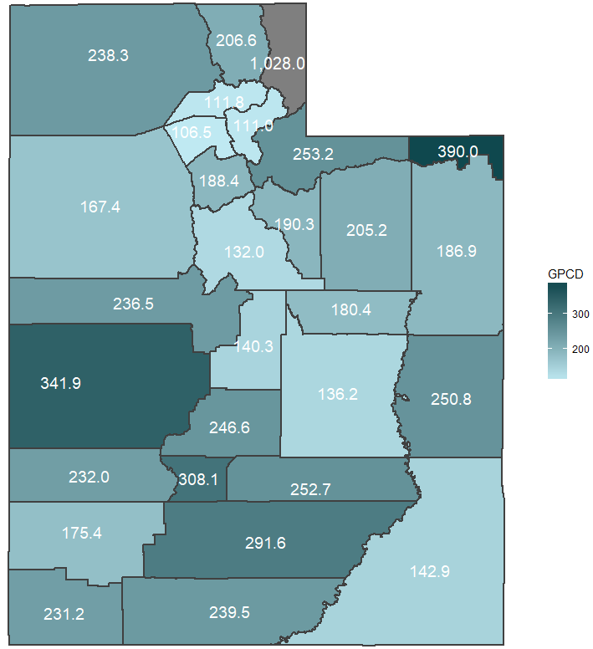
Water Demand | Gallons Per Capita Per Day
In terms of domestic public supply, Washington County ranked 16th lowest of 29 counties in per capita usage despite being located in the hottest and most arid region of the state
Source: Utah Department of Water Resources. Note: These figures are county-wide, GPCD reported elsewhere in this report refers to the Kanab/Virgin Basin

Slide 12
Water Demand | Gallons Per Capita Per Day
In terms of domestic public supply, Washington County ranked 16th lowest of 29 counties in per capita usage despite being located in the hottest and most arid region of the state
Source: Utah Department of Water Resources. Note: These figures are county-wide, GPCD reported elsewhere in this report refers to the Kanab/Virgin Basin

Slide 13
231.2
Gallons Per Capita Per Day in Washington County
Difference in Water Demand Figures
229.6
Gallons Per Capita Per Day in Virgin/Kanab Basin

Slide 14
271.4
Gallons Per Capita
Per Day Deliveries by WCWCD
Difference in Water Demand Figures
Approx. 15%
Non-Revenue Water
229.6
Gallons Per Capita Per Day Consumed in the Virgin/Kanab Basin

Slide 15
What has happened since the March 23, 2018 meeting…
The Division of Water Resources released official estimates of 2015 per capita water use for every county in the State of Utah
On-going refinement of both demand-side and supply-side assumptions
Updated presentation and analysis by University of Utah professors relative to price elasticity considerations for water use

Slide 16
Washington County Water Supply-Demand Balance
Baseline Annual Water Demand
(Population x GPCD)
Source: Washington County Water Conservancy District.

Slide 17
Water Demand Calculation
Population
Consumption (GPCD)
Total Water Demand
X
=

Slide 18
Washington County Water Supply-Demand Balance
Annual Water Demand Range
(Population x GPCD)
Source: Washington County Water Conservancy District.

Slide 19
Washington County Water Supply-Demand Balance
15-Year Water Supply Buffer
Annual Water Demand Range
(Population x GPCD)
Source: Washington County Water Conservancy District.

Slide 20
Washington County Water Supply-Demand Balance
15-Year Water Supply Buffer
Annual Water Demand Range
(Population x GPCD)
Existing Renewable, Reliable Supply
Source: Washington County Water Conservancy District.

Slide 21
Washington County Water Supply-Demand Balance
15-Year Water Supply Buffer
Annual Water Demand Range
(Population x GPCD)
Planned Supply
(other than LPP)
Existing Renewable, Reliable Supply
Source: Washington County Water Conservancy District.

Slide 22
Planned Water Resources on the Horizon
Project Name | Estimated Project Year | Reliable Yield (Acre Feet)
Ash Creek | 2019 | 2,840
Cottam Wells | 2019 | 600
Diamond Valley Well | 2019 | 400
Lake Powell Pipeline (“LPP”) | 2024 | 82,249
Pintura Well | 2019 | 600
Quail Creek WTP – Expansion | 2021 | -
Quail Creek WTP – Ozone Addition | 2019 | -
Sand Hollow Arsenic WTP | 2018 | -
Sand Hollow Regional Pipeline | 2018 | -
Sand Hollow Wells | 2019 | 3,000
Sand Hollow WTP | 2026 | -
Sullivan Wells | 2019 | 750
Total |  | 90,439
Source: 2017 Impact Fee Facilities Plan. The 2017 IFFP includes only facilities planned within the 2017-2026 planning window.

Slide 23
Washington County Water Supply-Demand Balance
Planned Supply Sourced to the Lake Powell Pipeline
15-Year Water Supply Buffer
Annual Water Demand Range
(Population x GPCD)
Planned Supply
(other than LPP)
Existing Renewable, Reliable Supply
Source: Washington County Water Conservancy District.

Slide 24
Washington County Water Supply-Demand Balance
Planned Supply Sourced to the Lake Powell Pipeline
Planned Supply Sourced to the Lake Powell Pipeline Reuse
15-Year Water Supply Buffer
Annual Water Demand Range
(Population x GPCD)
Planned Supply
(other than LPP)
Existing Renewable, Reliable Supply
Source: Washington County Water Conservancy District.

Slide 25
What has happened since the March 23, 2018 meeting…
The Division of Water Resources released official estimates of 2015 per capita water use for every county in the State of Utah
On-going refinement of both demand-side and supply-side assumptions
Updated presentation and analysis by University of Utah professors relative to price elasticity considerations for water use

Slide 26

Source: Professor Gail Blattenberger, Presentation to the Executive Water Finance Board, May 22, 2018.

Slide 27

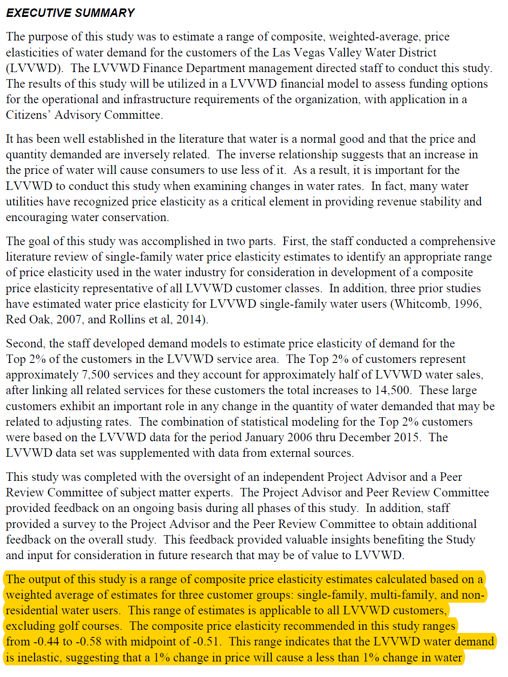
…midpoint of -0.51

Slide 28
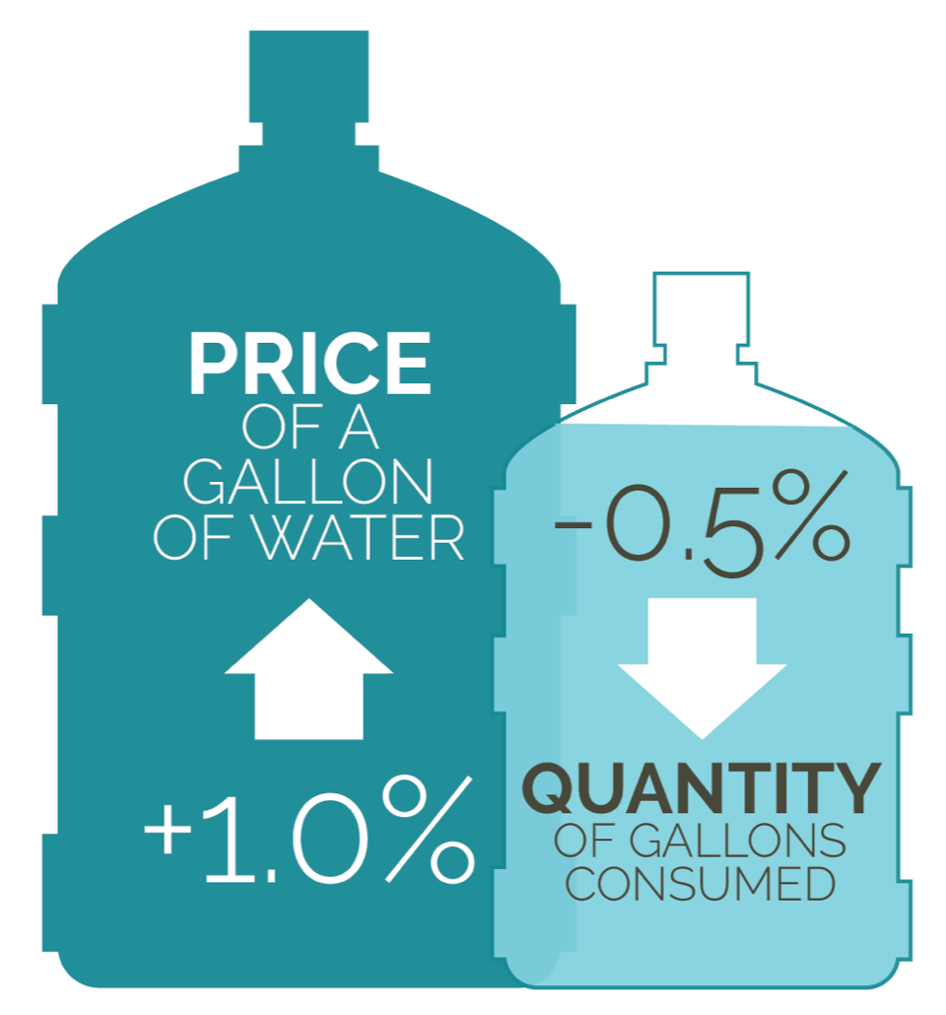
Price elasticity assumptions have been integrated into the WCWCD’s supply-demand estimates since 2016
Assumptions designed to be conservative
Additional study is needed on the sustainability of consumption behavior changes

Slide 29
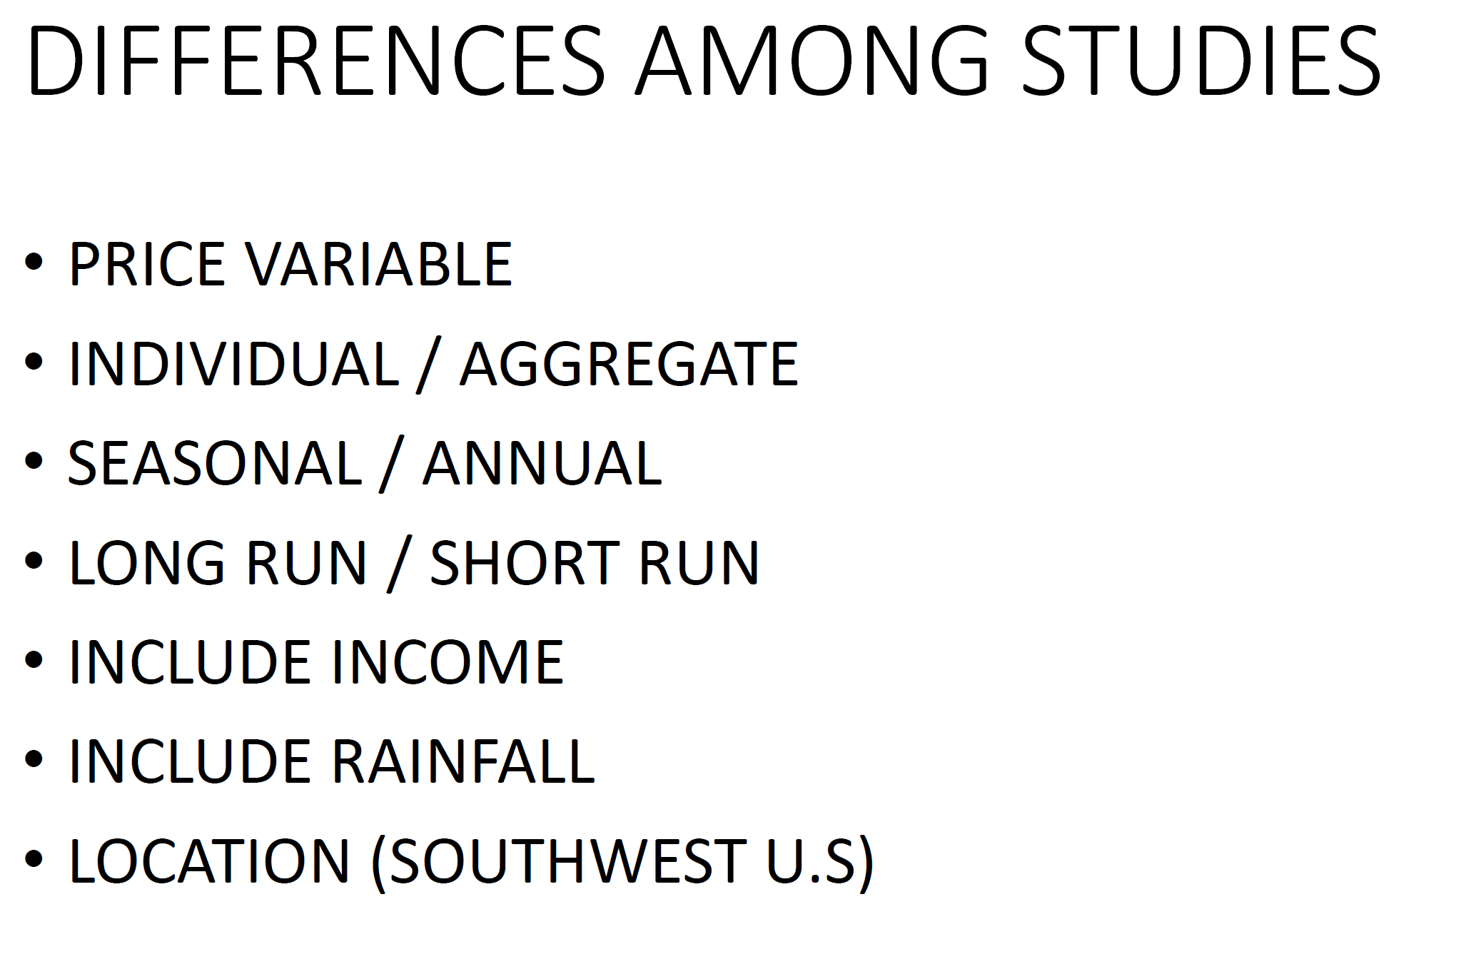
Price elasticity assumptions have been integrated into the WCWCD’s supply-demand estimates since 2016
Assumptions designed to be conservative
Additional study is needed on the sustainability of consumption behavior changes
Source: Professor Gail Blattenberger, Presentation to the Executive Water Finance Board, May 22, 2018.

Slide 30

Questions presented today…
Assumptions and sensitivities of WCWCD supply-demand water models
Water use per capita and future demand projections
State bonding and repayment to the state, including repayment sources
Price elasticity of demand estimates

Slide 31
Questions presented today…
Assumptions and sensitivities of WCWCD supply-demand water models
Water use per capita and future demand projections
State bonding and repayment to the state, including repayment sources
Price elasticity of demand estimates

Slide 32
Assumptions
Sensitivity

Slide 33
Assumptions
Sensitivity

Slide 34
Assumption #1
Washington County will experience population growth above the national average through 2060
169,245
Source: Kem C. Gardner Policy Institute

Slide 35
Planned Supply Sourced to the LPP
Planned Supply Sourced to LPP Reuse
Assumption #2
Existing water supplies will be inadequate to meet demand
15% Water Supply Buffer
Annual Water Demand Range
(Population x GPCD)
Planned Supply
(other than LPP)
Existing Renewable, Reliable Supply
Note: GPCD reflects net deliveries before accounting for non-revenue water, reflecting the amount of deliveries supplied by WCWCD.

Slide 36
Future Demand vs. Existing Supply
Population
+171%
Water Supply
+14%
Increase in population
between 2018 and 2060
according to the
Kem C. Gardner Policy Institute
Increase in renewable, reliable water sources being developed by WCWCD through 2020 (excludes the LPP)

Slide 37
Assumption #3
Higher water prices will result in less water demanded and increase conservation
Note: GPCD reflects net deliveries after accounting for non-revenue water, reflecting the amount of deliveries consumed by water customers.

Slide 38
Assumption #3
Higher water prices will result in less water demanded and increase conservation
Note: GPCD reflects net deliveries after accounting for non-revenue water, reflecting the amount of deliveries consumed by water customers.

Slide 39
Assumption #3
Higher water prices will result in less water demanded and increase conservation
229.6 GPCD
182.3 GPCD
47.3 GPCD
-20.6% Gallons/Person/Day
Note: GPCD reflects net deliveries after accounting for non-revenue water, reflecting the amount of deliveries consumed by water customers.

Slide 40
Assumption #3
Higher water prices will result in less water demanded and increase conservation
1,115.1 Billion Gallons
934.4 Billion Gallons
180.7 Billion Gallons
-16.2% Total Water Consumed

Slide 41
Assumption #4
Absent sufficient water, Washington County will not meet its economic potential and existing residents and businesses will be put at risk
 | Washington County Population (2016) | Metric per Acre Foot Demanded (64,172 AF) | Additional Economic Potential (82,249 AF) [4]
Population [1] | 160,371 | 2.50 | 205,623
Households [1] | 58,062 | 0.90 | 74,024
Employment [2] | 60,188 | 0.94 | 77,143
Businesses [2] | 5,371 | 0.08 | 6,884
Personal Income [3] | $5.3 B | $83,000 | $6.8 B
Wages & Salaries [2] | $2.1 B | $33,000 | $2.7 B
Gross Regional Product [3] | $5.1 B | $80,000 | $6.6 B
[1] Kem C. Gardner Policy Institute
[2] U.S. Bureau of Labor Statistics Quarterly Census of Employment and Wages; Washington County, Utah
[3] U.S. Bureau of Economic Analysis Regional Data: Washington County, Utah or St. George MSA
[4] Baseline estimates. Notes that the effects of conservation, advancements in construction technology and economic diversification have the potential to significantly increase the simple calculations provided.

Slide 42
Assumption #5
Washington County will need to raise additional funds to build the Lake Powell Pipeline and other necessary water infrastructure
Wholesale Water Rates
Annual increases of $0.10 per 1,000 gallons to $3.00 per 1,000 gallons
Impact Fees
Annual increases of $1,000 per equivalent residential unit (ERU) to $15,809 in 2025, continuing to increase as indexed to the Construction Materials Producer Price Index
Property Taxes
Phasing in maximum allowable rate of 0.001 percent over a 10-year period
1
2
3

Slide 43
Assumption #5
Washington County will need to raise additional funds to build the Lake Powell Pipeline and other necessary water infrastructure
Project | Cost (2017 Dollars) | Cost (YoE Dollars)
Ash Creek Project | $37,459,000 | $39,279,000
Cottam Wells | $1,063,000 | $1,106,000
Diamond Valley Well | $3,249,000 | $3,380,000
Pintura Well | $3,350,000 | $3,485,000
Quail Creek WTP Expansion (80) | $37,500,000 | $40,265,000
Quail Creek WTP Ozone | $11,840,000 | $12,415,000
Sand Hollow Regional Pipeline | $16,210,000 | $16,599,000
Sand Hollow Arsenic WTP | $6,798,000 | $6,934,000
Sand Hollow Wells | $8,977,000 | $9,340,000
Sand Hollow WTP | $46,000,000 | $53,034,000
Sullivan Wells | $2,718,000 | $2,828,000
Lake Powell Pipeline | $1,377,609,000 | $1,514,697,000
Water Rights | $5,000,000 | $5,000,000
Totals | $1,557,773,000 | $1,708,362,000
Source: WCWCD Impact Fee Facilities Plan, 2017

Slide 44
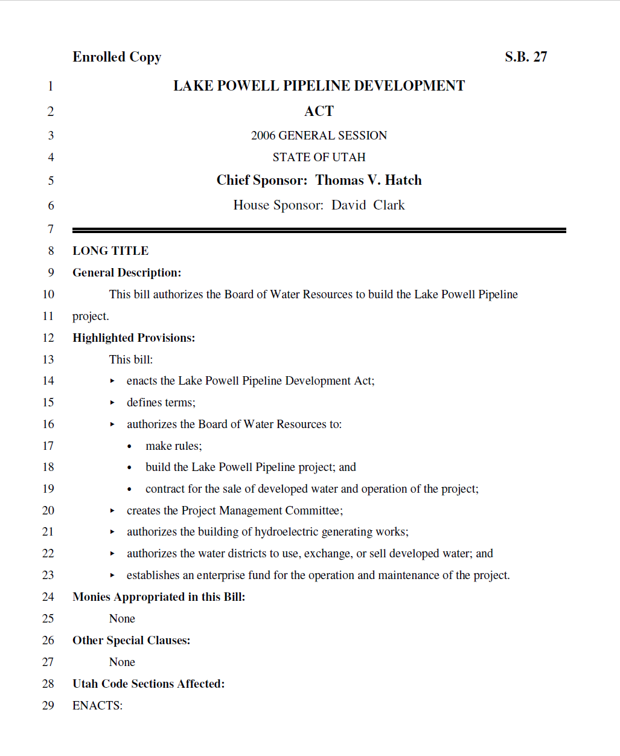
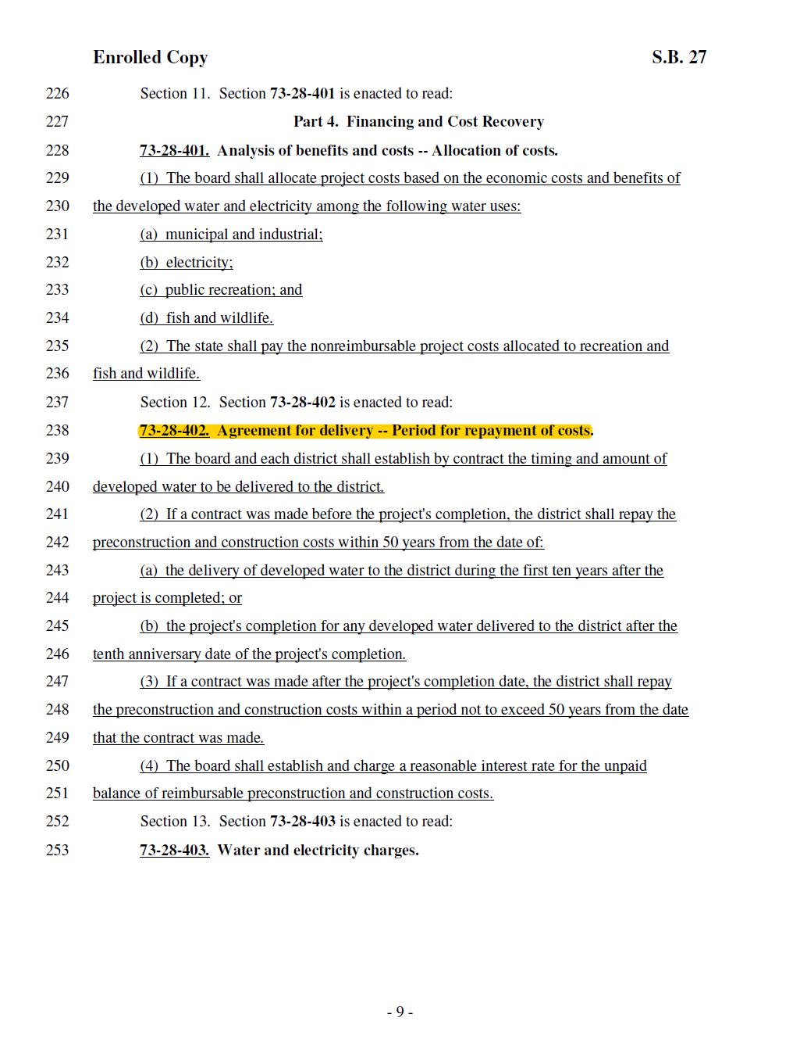
Assumption #6
The Lake Powell Pipeline will be financed in a manner consistent with the Lake Powell Pipeline Development Act of 2006 and the Interpretation Provided by the Division of Water Resources

Slide 45
Assumptions
Sensitivity

Slide 46
Sensitivity #1
What happens if Washington County grows faster or slower than anticipated?
72,842 Acre Feet

Slide 47
Sensitivity #2
What if existing water supplies prove less robust than anticipated due to worsening drought conditions?

Slide 48
Sensitivity #2
What if existing water supplies prove less robust than anticipated due to worsening drought conditions?

Slide 49
Sensitivity #2
What if existing water supplies prove less robust than anticipated due to worsening drought conditions?

Slide 50
Sensitivity #2
What if existing water supplies prove less robust than anticipated due to worsening drought conditions?

Slide 51
Sensitivity #2
What if existing water supplies prove less robust than anticipated due to worsening drought conditions?

Slide 52
Sensitivity #2
What if existing water supplies prove less robust than anticipated due to worsening drought conditions?

Slide 53
Sensitivity #2
What if existing water supplies prove less robust than anticipated due to worsening drought conditions?
Source: United States Geological Survey

Slide 54
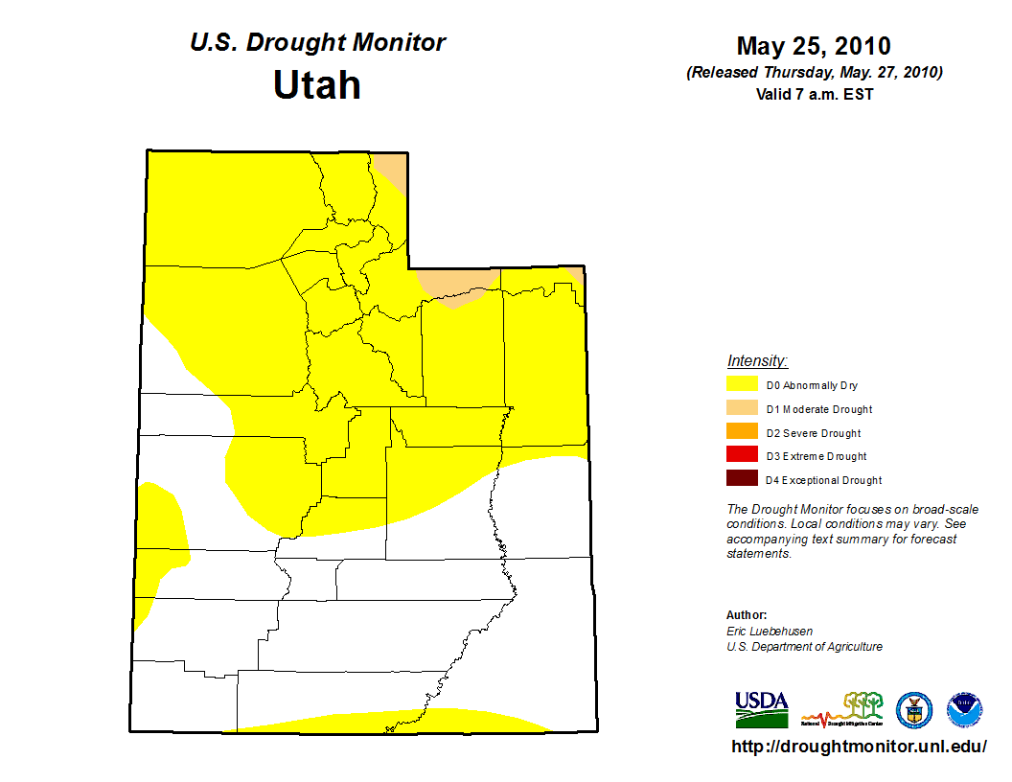
Sensitivity #2
What if existing water supplies prove less robust than anticipated due to worsening drought conditions?
Source: University of Nebraska, Lincoln and NOAA

Slide 55
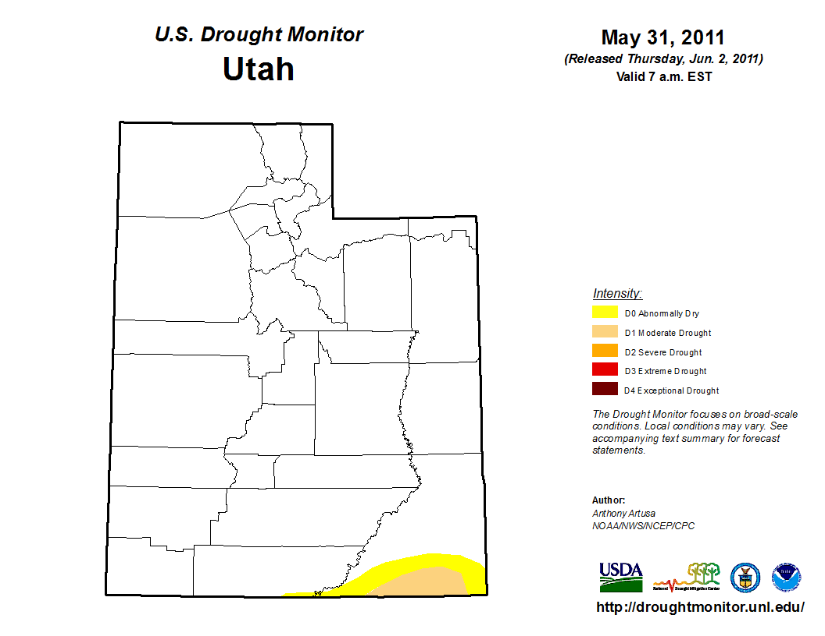
Sensitivity #2
What if existing water supplies prove less robust than anticipated due to worsening drought conditions?
Source: University of Nebraska, Lincoln and NOAA

Slide 56
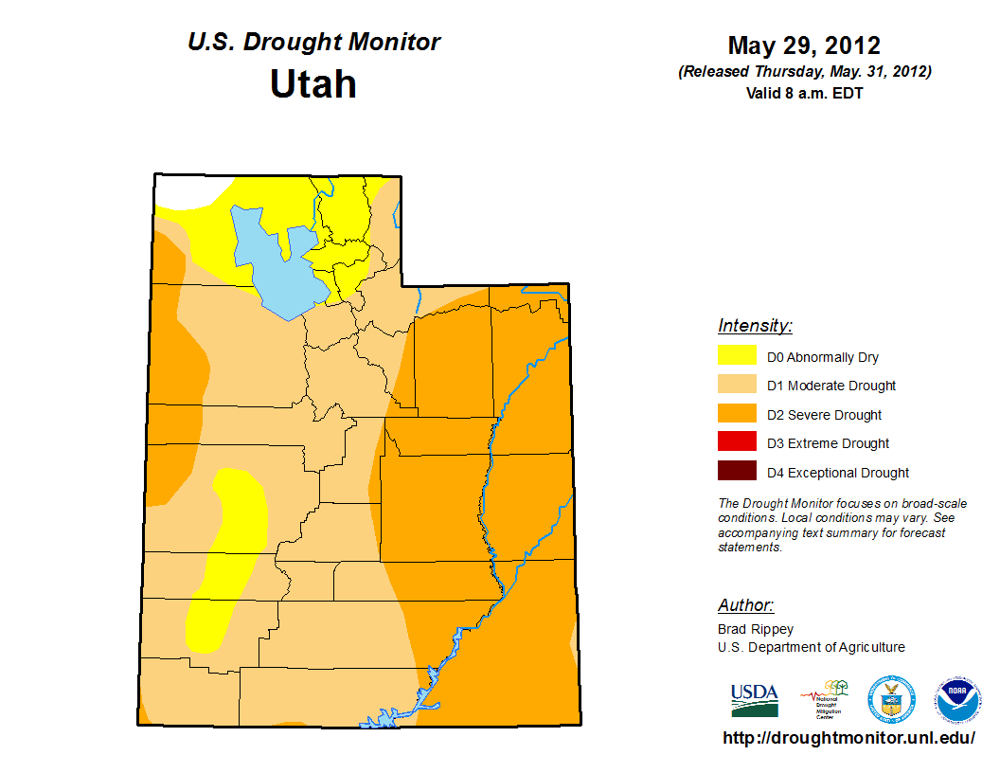
Sensitivity #2
What if existing water supplies prove less robust than anticipated due to worsening drought conditions?
Source: University of Nebraska, Lincoln and NOAA

Slide 57
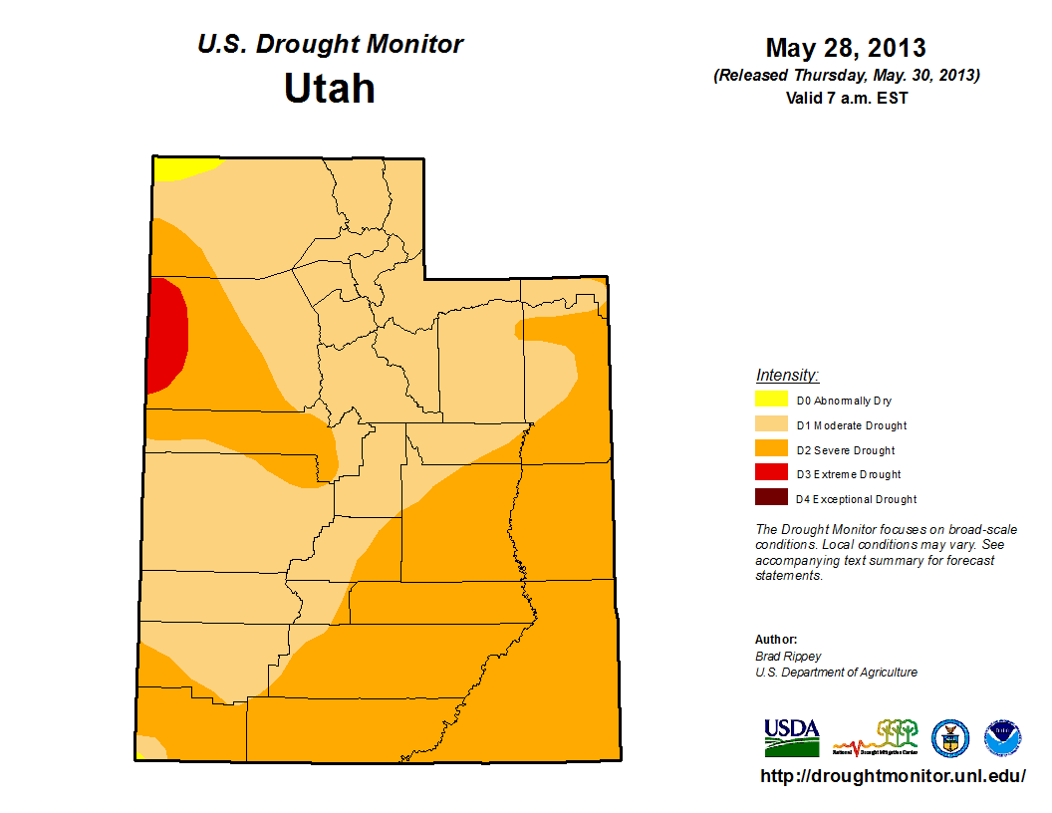
Sensitivity #2
What if existing water supplies prove less robust than anticipated due to worsening drought conditions?
Source: University of Nebraska, Lincoln and NOAA

Slide 58
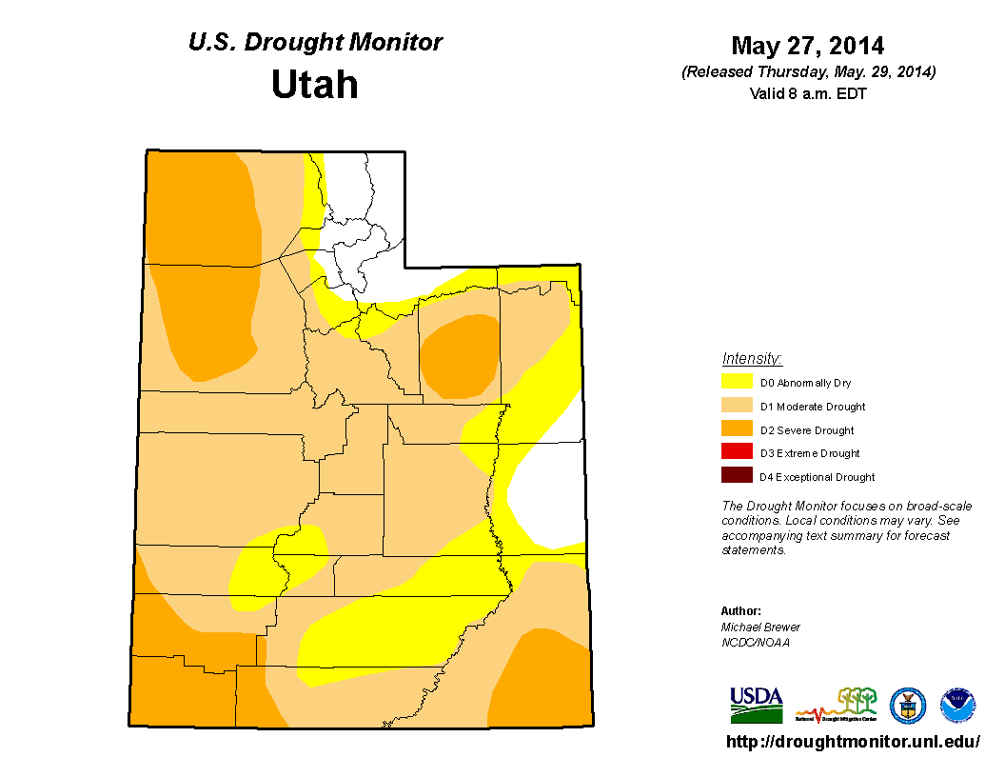
Sensitivity #2
What if existing water supplies prove less robust than anticipated due to worsening drought conditions?
Source: University of Nebraska, Lincoln and NOAA

Slide 59
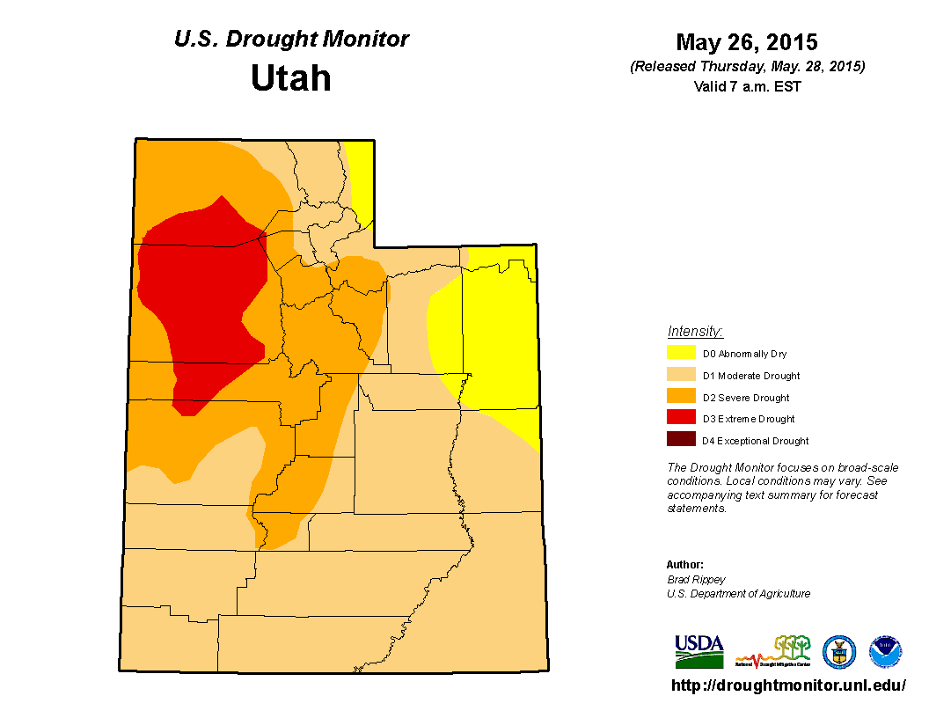
Sensitivity #2
What if existing water supplies prove less robust than anticipated due to worsening drought conditions?
Source: University of Nebraska, Lincoln and NOAA

Slide 60
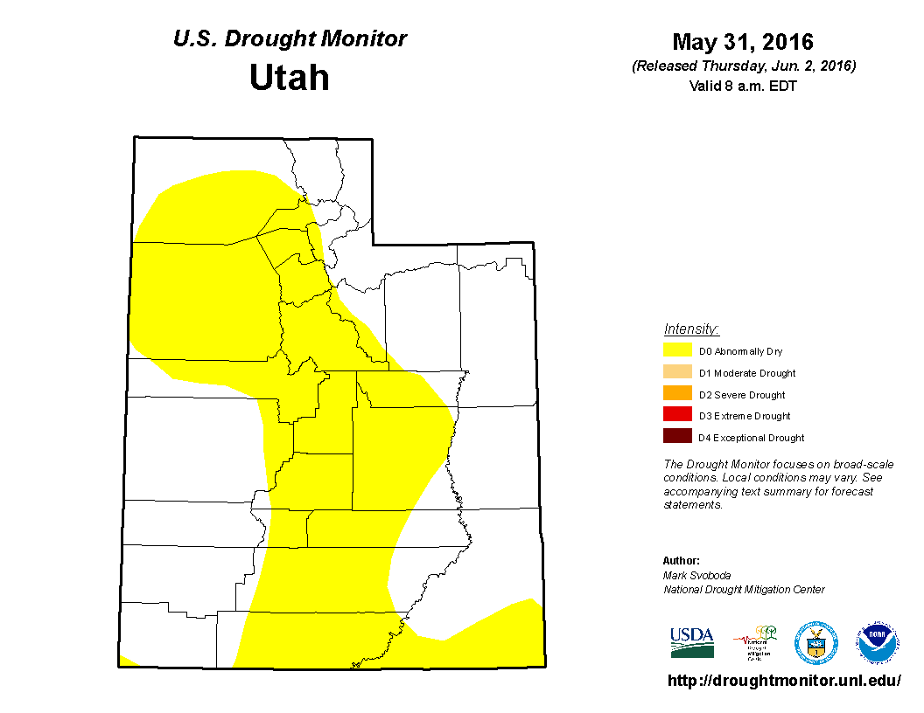
Sensitivity #2
What if existing water supplies prove less robust than anticipated due to worsening drought conditions?
Source: University of Nebraska, Lincoln and NOAA

Slide 61
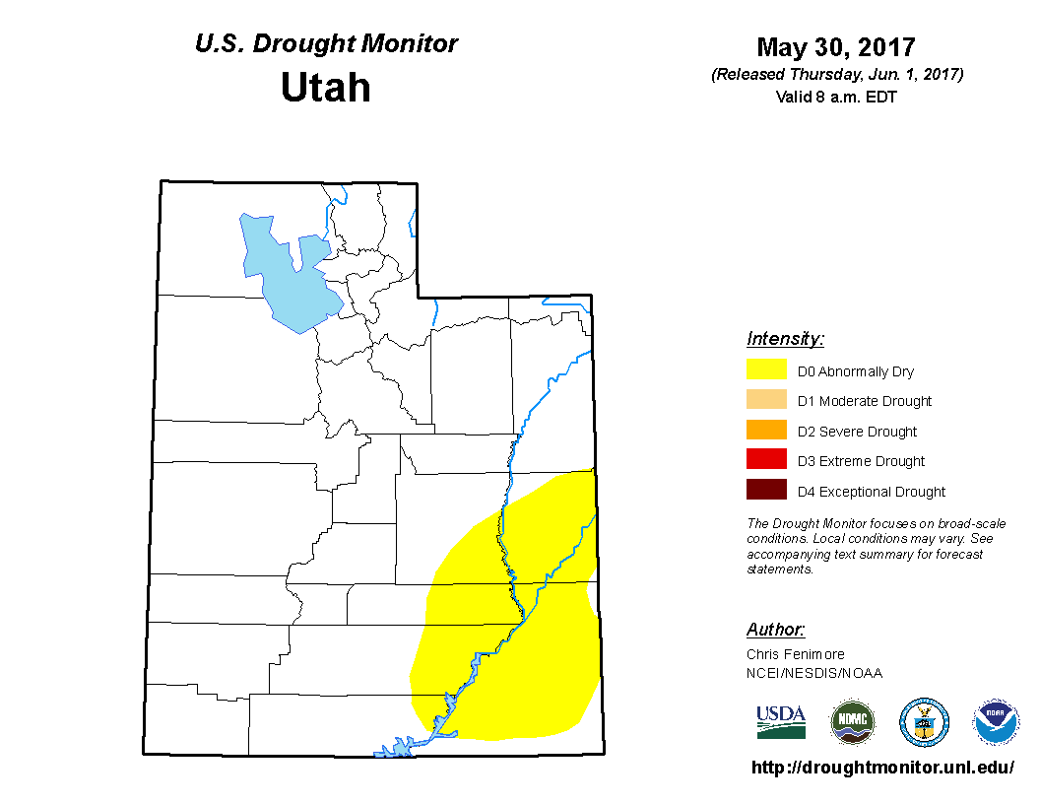
Sensitivity #2
What if existing water supplies prove less robust than anticipated due to worsening drought conditions?
Source: University of Nebraska, Lincoln and NOAA

Slide 62
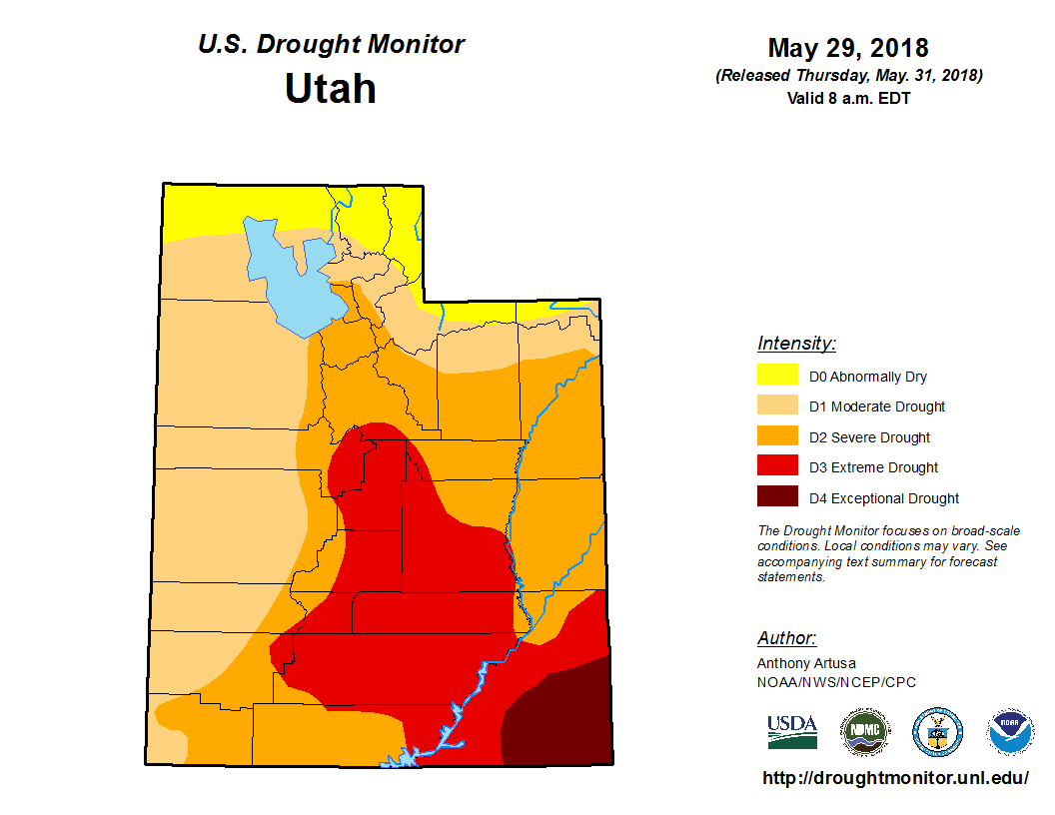
Sensitivity #2
What if existing water supplies prove less robust than anticipated due to worsening drought conditions?
Source: University of Nebraska, Lincoln and NOAA

Slide 63
Sensitivity #3
What is the revenue generating capacity of WCWCD considering price elasticity and conservation?
GPCD: 229.6
GPCD: 182.3
Source: Kem C. Gardner Policy Institute. Note: GPCD reflects net deliveries before accounting for non-revenue water, reflecting the amount of deliveries made by WCWCD.

Slide 64
Pricing Element #1
Analysis of Water Rates

Slide 65
Sensitivity #3
What is the revenue generating capacity of WCWCD considering price elasticity and conservation?
WCWCD-Sourced Deliveries
Municipal-Sourced Deliveries
Note: GPCD reflects net deliveries before accounting for non-revenue water, reflecting the amount of deliveries made by WCWCD.

Slide 66
Sensitivity #3
What is the revenue generating capacity of WCWCD considering price elasticity and conservation?
Water Rates
Period | Current GPCD | Total WCWCD Deliveries | Wholesale Rate Increase | Capital Yield
2020 | 271.4 | 9.27 B gallons | $0.10 | $0.93 M
2025 | 271.4 | 12.4 B gallons | $0.10 | $1.24 M
2030 | 271.4 | 15.5 B gallons | $0.10 | $1.55 M
2035 | 271.4 | 18.9 B gallons | $0.10 | $1.89 M
2040 | 271.4 | 22.2 B gallons | $0.10 | $2.22 M
2045 | 271.4 | 25.5 B gallons | $0.10 | $2.55 M
2050 | 271.4 | 29.0 B gallons | $0.10 | $2.90 M
2055 | 271.4 | 32.6 B gallons | $0.10 | $3.26 M
2060 | 271.4 | 36.4 B gallons | $0.10 | $3.64 M
2018-2060 | 271.4 | 934.2 B gallons | $0.10 | $93.42 M
Note: GPCD reflects net deliveries before accounting for non-revenue water, reflecting the amount of deliveries made by WCWCD. Wholesale Capital Charge per 1,000 gallons.

Slide 67
Sensitivity #3
What is the revenue generating capacity of WCWCD considering price elasticity and conservation?
Water Rates
Period | Adjusted GPCD | Total WCWCD Deliveries | Wholesale Rate Increase | Capital Yield
2020 | 265.0 | 8.98 B gallons | $0.10 | $0.90 M
2025 | 253.9 | 11.2 B gallons | $0.10 | $1.12 M
2030 | 243.4 | 13.2 B gallons | $0.10 | $1.32 M
2035 | 233.0 | 15.2 B gallons | $0.10 | $1.52 M
2040 | 223.7 | 17.0 B gallons | $0.10 | $1.70 M
2045 | 215.3 | 18.7 B gallons | $0.10 | $1.87 M
2050 | 215.3 | 21.4 B gallons | $0.10 | $2.14 M
2055 | 215.3 | 24.3 B gallons | $0.10 | $2.43 M
2060 | 215.3 | 27.4 B gallons | $0.10 | $2.74 M
2018-2060 | 232.0 | 730.4 B gallons | $0.10 | $73.04 M
Note: GPCD reflects net deliveries before accounting for non-revenue water, reflecting the amount of deliveries made by WCWCD. Wholesale Capital Charge per 1,000 gallons.

Slide 68
Sensitivity #3
What is the revenue generating capacity of WCWCD considering price elasticity and conservation?
Water Rates
Period | Adjusted GPCD | Total WCWCD Deliveries | Wholesale Rate Increase | Capital Yield
2020 | 265.0 | 8.98 B gallons | $0.50 | $4.49 M
2025 | 253.9 | 11.2 B gallons | $1.00 | $11.18 M
2030 | 243.4 | 13.2 B gallons | $1.50 | $19.77 M
2035 | 233.0 | 15.2 B gallons | $2.00 | $30.37 M
2040 | 223.7 | 17.0 B gallons | $2.50 | $42.41 M
2045 | 215.3 | 18.7 B gallons | $3.00 | $55.96 M
2050 | 215.3 | 21.4 B gallons | $3.00 | $64.25 M
2055 | 215.3 | 24.3 B gallons | $3.00 | $72.98 M
2060 | 215.3 | 27.4 B gallons | $3.00 | $82.10 M
2018-2060 | 232.0 | 730.4 B gallons | $2.12 | $1,746.6 M
Note: GPCD reflects net deliveries before accounting for non-revenue water, reflecting the amount of deliveries made by WCWCD. Wholesale Capital Charge per 1,000 gallons.

Slide 69
Pricing Element #2
Impact Fees

Slide 70
Population Growth
Equivalent Residential Connections
Source: Kem C. Gardner Policy Institute

Slide 71
Sensitivity #3
What is the revenue generating capacity of WCWCD considering price elasticity and conservation?

Slide 72
Sensitivity #3
What is the revenue generating capacity of WCWCD considering price elasticity and conservation?
Impact Fees
Period | ERC Added | New Home Value | Impact Fee per Connection | Percent of Home Value | Impact Fee Revenue
2020 | 2,977 | $367,000 | $10,417 | 2.8% | $31.0 M
2025 | 2,755 | $413,200 | $15,809 | 3.7% | $41.6 M
2030 | 3,037 | $465,200 | $16,971 | 3.6% | $51.5 M
2035 | 3,113 | $523,800 | $19,089 | 3.6% | $59.4 M
2040 | 3,035 | $589,700 | $21,474 | 3.6% | $65.2 M
2045 | 3,130 | $664,000 | $24,160 | 3.6% | $75.6 M
2050 | 3,272 | $747,600 | $27,183 | 3.6% | $89.0 M
2055 | 3,435 | $841,700 | $30,586 | 3.6% | $105.1 M
2060 | 3,585 | $947,700 | $34,455 | 3.6% | $123.4 M
2018-2060 | 138,162 | $601,200 | $21,512 | 3.6% | $2,961.8 M

Slide 73
Pricing Element #3
Property Taxes

Slide 74
Sensitivity #3
What is the revenue generating capacity of WCWCD considering price elasticity and conservation?

Slide 75
Sensitivity #3
What is the revenue generating capacity of WCWCD considering price elasticity and conservation?
Property Taxes
Period | Taxable Value | WCWCD Property Tax Rate | Property Tax Revenue
2020 | $15.8 B | $0.000743 | $11.8 M
2025 | $20.5 B | $0.001000 | $20.5 M
2030 | $25.9 B | $0.001000 | $25.9 M
2035 | $32.5 B | $0.001000 | $32.5 M
2040 | $40.1 B | $0.001000 | $40.1 M
2045 | $48.9 B | $0.001000 | $48.9 M
2050 | $59.3 B | $0.001000 | $59.3 M
2055 | $71.7 B | $0.001000 | $71.7 M
2060 | $86.3 B | $0.001000 | $86.3 M
2018-2060 | $1,851.2 B | $0.000969 | $1,821.9 M

Slide 76
Sensitivity #4
What happens if the State changes its interpretation of the Lake Powell Pipeline Act?

Slide 77
Sensitivity #5
What happens in the event that population grows slower than expected, conservation is greater than expected, and Washington County builds the Lake Powell Pipeline Project on the current timeline?
Build It, and They Don’t Come Scenario…
 | Baseline Scenario (2026 Completion) | Alternate Scenario (2026 Completion)
Average Annual Population | 309,419 | 284,860
2060 Population | 458,960 | 410,442
Average Annual Water Consumption | 25.7 B gallons | 20.5 B gallons
2060 Water Consumption | 36.1 B gallons | 28.1 B gallons
Average GPCD | 196.3 | 170.0
Consumption > Supply | 2035 | 2051
Total Project Cost | $2.1 B | $2.1 B
Water Rate Revenue | $1.7 B | $1.2 B
Impact Fee Revenue | $3.0 B | $2.5 B
Property Tax Revenue | $1.8 B | $1.6 B
Total Revenue Capacity | $6.5 B | $5.3 B
Note: GPCD reflects net deliveries after non-revenue deliveries, reflecting the amount of deliveries consumed by water customers.

Slide 78
Sensitivity #6
What happens in the event that population grows faster than expected, conservation is less than expected, and Washington County delays building the Lake Powell Pipeline Project five years?
Don’t Build It, and They Come Anyway Scenario…
 | Baseline Scenario (2026 Completion) | Alternate Scenario (2031 Completion)
Average Annual Population | 309,419 | 324,141
2060 Population | 458,960 | 490,827
Average Annual Water Consumption | 25.7 B gallons | 30.5 B gallons
2060 Water Consumption | 36.1 B gallons | 43.7 B gallons
Average GPCD | 196.3 | 223.2
Consumption > Supply | 2035 | 2027
Total Project Cost | $2.1 B | $3.2 B
Water Rate Revenue | $1.7 B | $2.2 B
Impact Fee Revenue | $3.0 B | $3.3 B
Property Tax Revenue | $1.8 B | $1.9 B
Total Revenue Capacity | $6.5 B | $7.4 B
Note: GPCD reflects net deliveries after non-revenue deliveries, reflecting the amount of deliveries consumed by water customers.

Slide 79
Questions presented today…
Assumptions and sensitivities of WCWCD supply-demand water models
Water use per capita and future demand projections
State bonding and repayment to the state, including repayment sources
Price elasticity of demand estimates

Slide 80
Water Demand | Gallons Per Capita Per Day
In terms of domestic public supply, Washington County ranked 16th lowest of 29 counties in per capita usage despite being located in the hottest and most arid region of the state
Source: Utah Department of Water Resources. Note: These figures are county-wide, GPCD reported elsewhere in this report refers to the Kanab/Virgin Basin

Slide 81
Gallons Per Capita Per Day and Total Water Demand
WCWCD-Sourced Deliveries
Municipal-Sourced Deliveries
Note: GPCD reflects net deliveries after non-revenue deliveries, reflecting the amount of deliveries consumed by water customers.

Slide 82
Questions presented today…
Assumptions and sensitivities of WCWCD supply-demand water models
Water use per capita and future demand projections
State bonding and repayment to the state, including repayment sources
Price elasticity of demand estimates

Slide 83
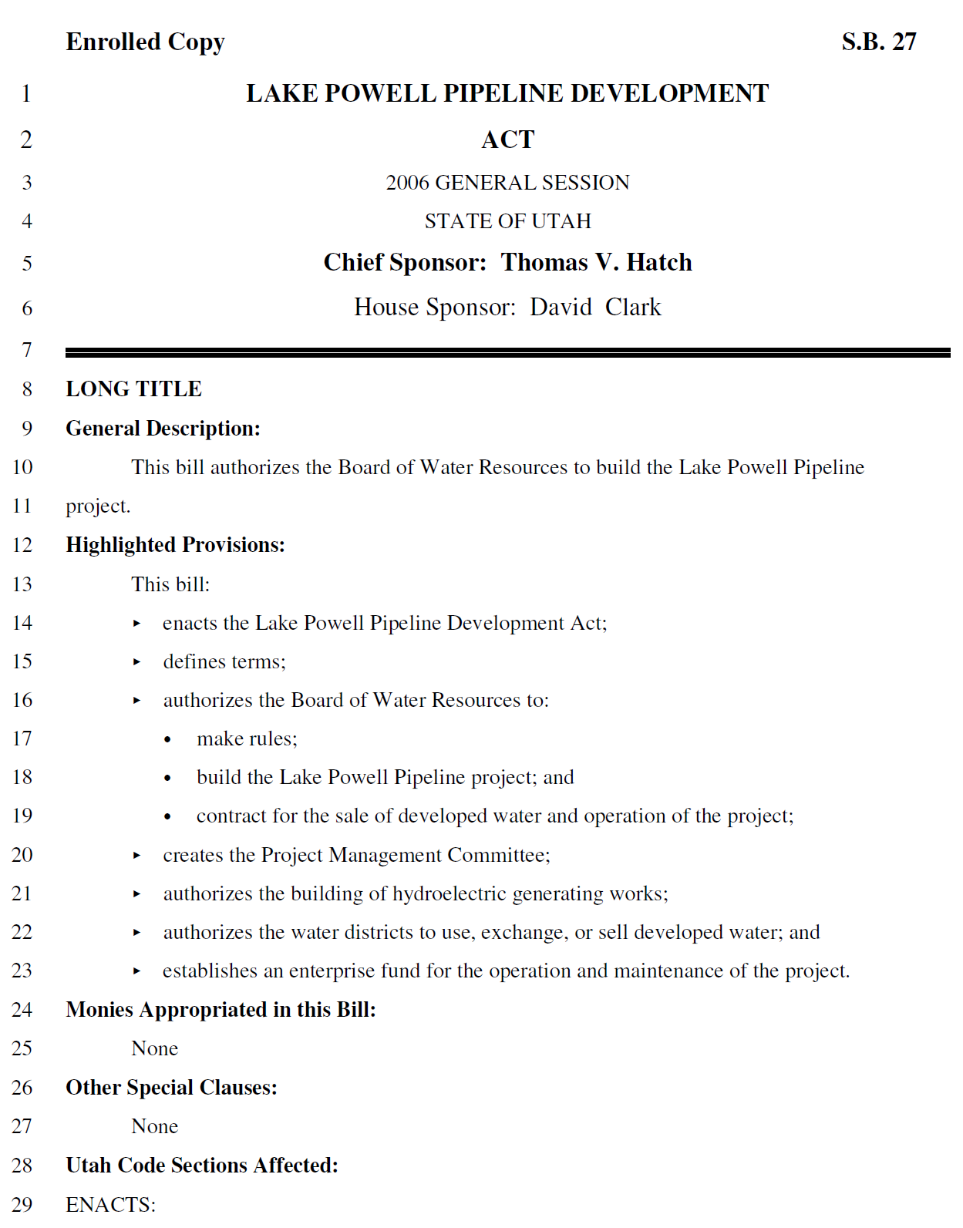
Lake Powell Pipeline Development Act Scenario…
1
State of Utah issues bonds for the construction of the Lake Powell Pipeline
2
Washington County takes down blocks of water, as needed, incurring the cost of each block when it is taken down
3
Washington County pays for each block of water it takes down using pay-go funds (impact fees) to the extent available, financing the balance, utilizing water rates and property taxes, at terms consistent with Act

Slide 84
How Might This Look from the State of Utah’s Perspective?
Project Cost: | $1,377,609,000 (2017 Dollars) $1,514,697,000 (2021 Dollars; At Bond Issuance)
Assumed Term: | 15 Years
Assumed Interest Rate: | 4.0%
Structure: | Fully Amortizing
Annual Debt Service: | $136,233,525 (Principal and Interest)
Total Debt Service: | $2,043,502,877 ($136.2 Million x 15 Years)
Note: The modeled financing scenario is for illustrative purposes and does not attempt to account for a premium/discount structure, issuance costs, debt service reserve requirements, coverage or other bonding considerations. Estimates reflect principal and interest based on the total project cost. Annual cost escalations of 2.4 percent are assumed, along with a 2021 bond issuance timeframe.

Slide 85
How Might This Look from the State of Utah’s Perspective?
Debt Service by the State of Utah
Annual $136.2 Million | Cumulative $2.0 Billion
Payments from WCWCD for Purchase of Water Blocks
Annual Payments Vary | Cumulative $2.0 Billion
Initial Water Takedown of 15,600 AF
Average Annual Water Takedown of 2,772 AF for 24 Years

Slide 86
How Might This Look from WCWCD’s Perspective?
Water Block Takedowns (in AF)
Total of 82,249 AF
Payments to State for Purchase of Water Blocks
Annual Payments Vary | Cumulative $2.0 Billion
Initial Water Takedown of 15,600 AF
Initial Water Takedown of 15,600 AF
Average Annual Water Takedown of 2,772 AF for 24 Years
Average Annual Water Takedown of 2,772 AF for 24 Years

Slide 87
How Might This Look from WCWCD’s Perspective?
Water Block Takedowns
Total of 82,249 AF
Sources of Payments for Purchase of Water Blocks
Annual Payments Vary | Cumulative $2.0 Billion
Initial Water Takedown of 15,600 AF
Average Annual Water Takedown of 2,772 AF for 24 Years

Slide 88
How Might This Look from WCWCD’s Perspective?
Water Block Takedowns
Total of 82,249 AF
Sources of Payments for Purchase of Water Blocks
Annual Payments Vary | Cumulative $2.0 Billion
Initial Water Takedown of 15,600 AF
Average Annual Water Takedown of 2,772 AF for 24 Years
$2.0 Billion

Slide 89
How Might This Look from WCWCD’s Perspective?
Water Block Takedowns
Total of 82,249 AF
Cash Payments for Purchase of Water Blocks
Annual Payments Vary | Cumulative $2.1 Billion
Initial Water Takedown of 15,600 AF
Average Annual Water Takedown of 2,772 AF for 24 Years
$2.1 Billion
(Includes Interest on Amounts Financed)

Slide 90
How Might This Look from WCWCD’s Perspective?
Water Block Takedowns
Total of 82,249 AF
Timing of Payments for Purchase of Water Blocks
Annual Payments Vary | Cumulative $2.1 Billion
Initial Water Takedown of 15,600 AF
Average Annual Water Takedown of 2,772 AF for 24 Years

Slide 91
Would Washington County Have Sufficient Funds to Make the Required Payments?
Incremental Revenues by Source
Presented Annually
Timing of Payments for Purchase of Water Blocks
Annual Payments Vary | Cumulative $2.1 Billion

Slide 92
Would Washington County Have Sufficient Funds to Make the Required Payments?
Incremental Revenues by Source
Presented Cumulatively
Timing of Payments for Purchase of Water Blocks
Annual Payments Vary | Cumulative $2.1 Billion

Slide 93
Notably, the Development of a Financing Model Remains Premature
Important assumptions continue
to be refined…
The final cost of the Lake Powell Pipeline
The timing of the Lake Powell Pipeline
The financing environment, interest rates
Reserve and coverage requirements
Financing structure of water blocks
Market reactions to rate increases
Adoption of conservation measures
Demographic, socioeconomic trends
Trends in development
State and federal water policy

Slide 94
Questions presented today…
Assumptions and sensitivities of WCWCD supply-demand water models
Water use per capita and future demand projections
State bonding and repayment to the state, including repayment sources
Price elasticity of demand estimates

Slide 95
Price Elasticity of Demand Considered in Supply-Demand Estimates
ԑ = -0.5037
at every point on the demand curve

Slide 96
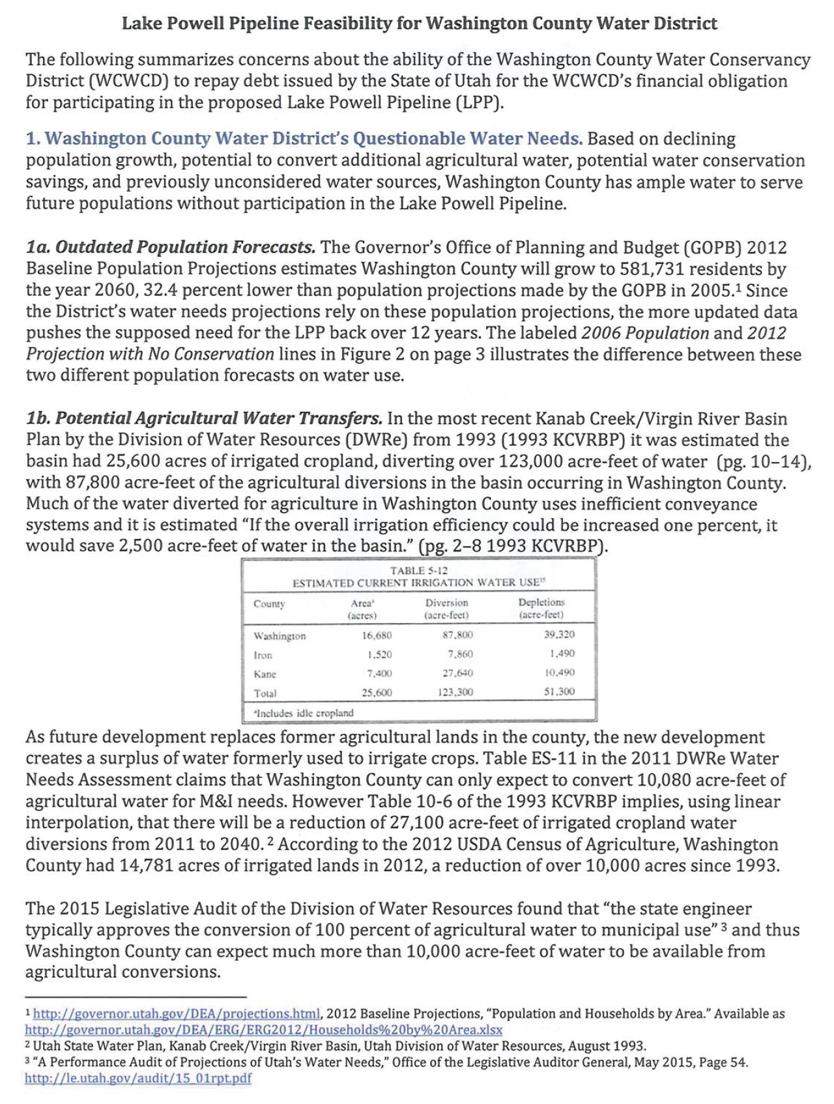
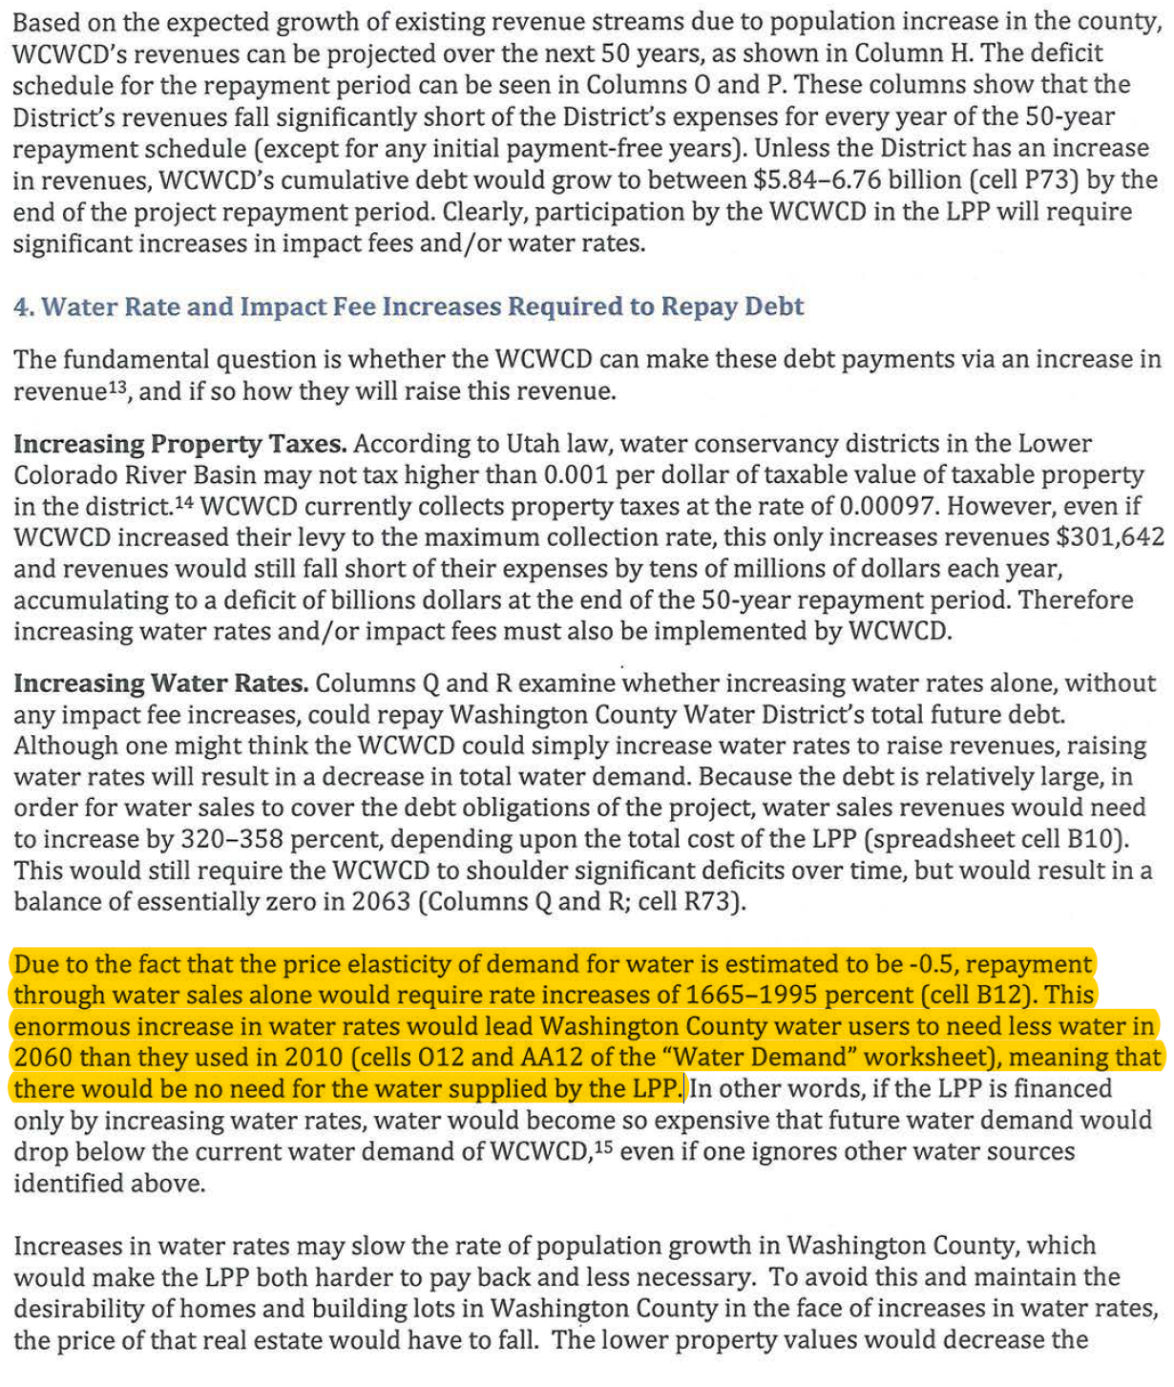
How then do we square all of this with a University of Utah report that states…
Due to the fact that the price elasticity of demand for water is estimated to be -0.5, repayment through water sales alone would require rate increases of 1665-1995 percent. This enormous increase in water rates would lead Washington County water users to need less water in 2060 than they used in 2010, meaning that there would be no need for the water supplied by the LPP.

Slide 97
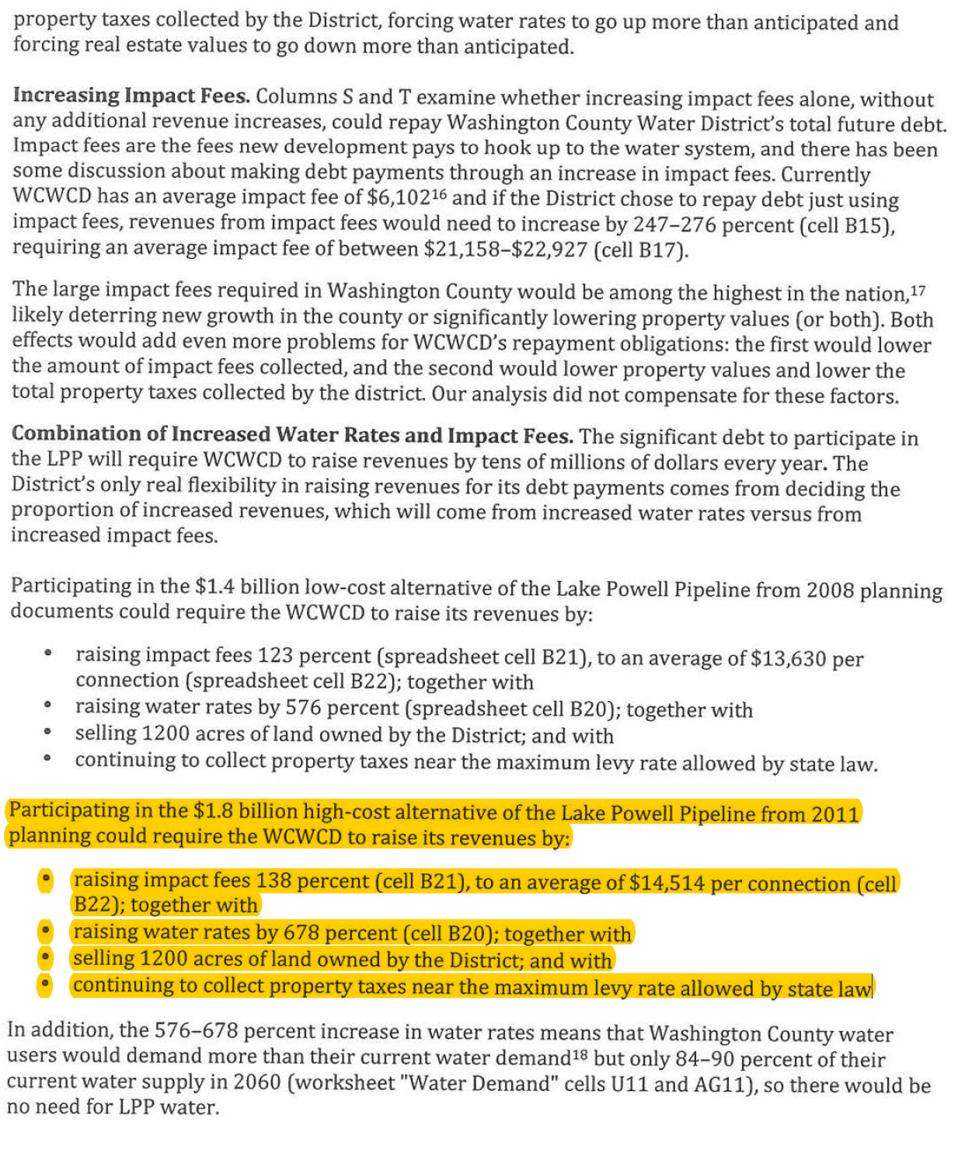
How then do we square all of this with a University of Utah report that states…
Funding the Lake Powell pipeline will require a 138 percent increase in impact fees, a 698 percent increase in water rate, selling 1,200 acres of owned property and increasing property taxes to the maximum extent by law

Slide 98
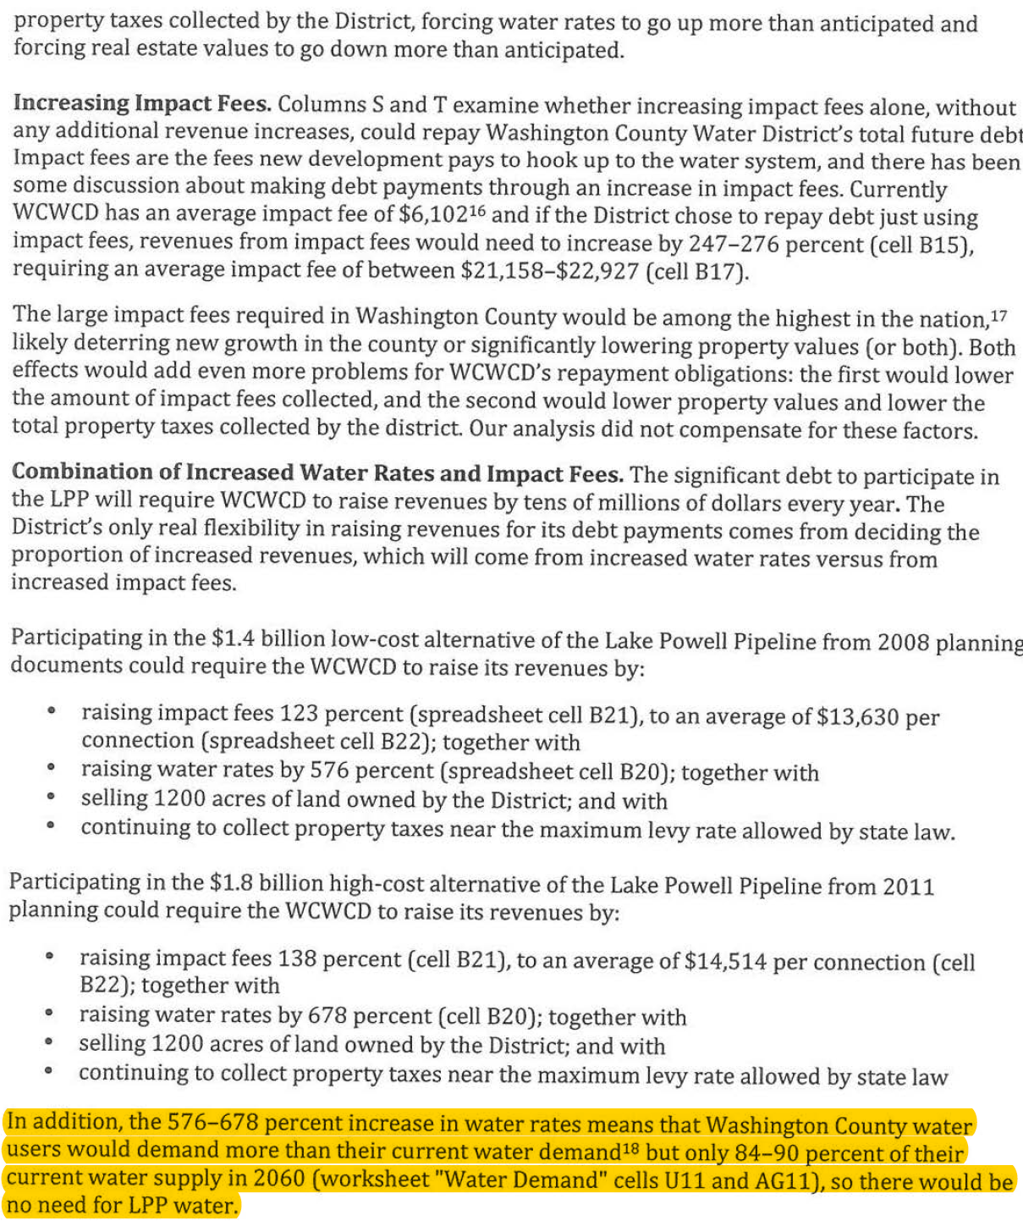
How then do we square all of this with a University of Utah report that states…
Increases in water rates from 576 to 678 percent means Washington County water user would demand less than 90 percent of their current water supply, so there would be no need for Lake Powell Pipeline Water

Slide 99
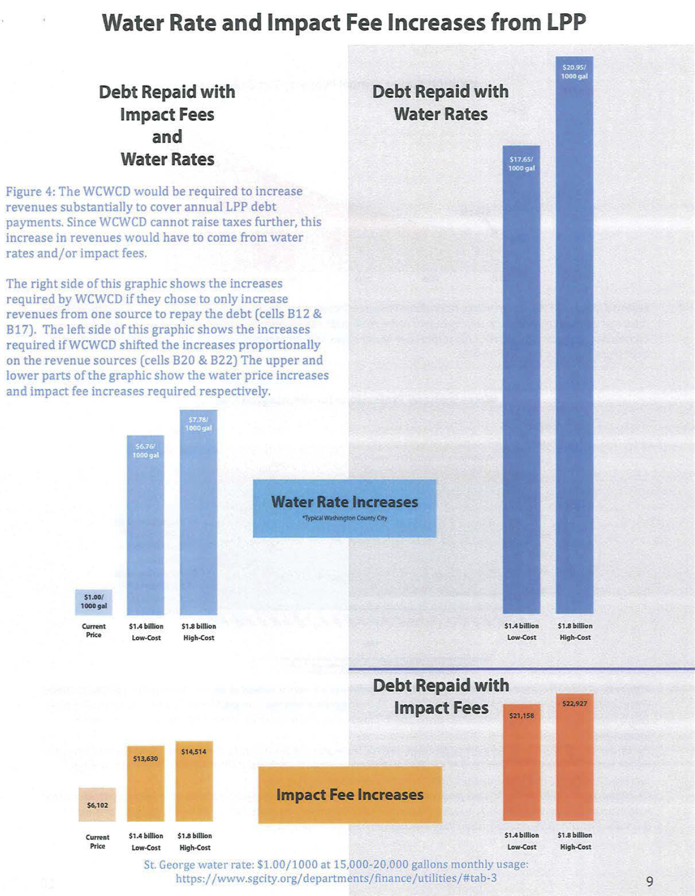
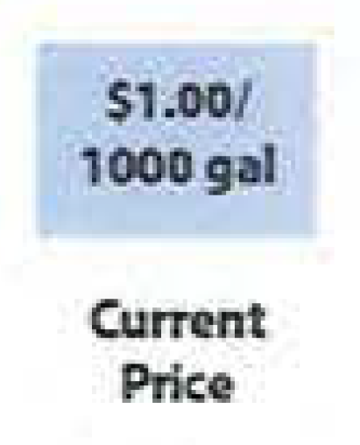
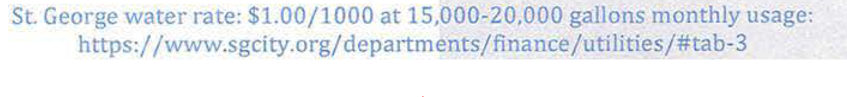
Reason #1
University of Utah Professors Use a Misleading and Inconsistent Price of Water

Slide 100
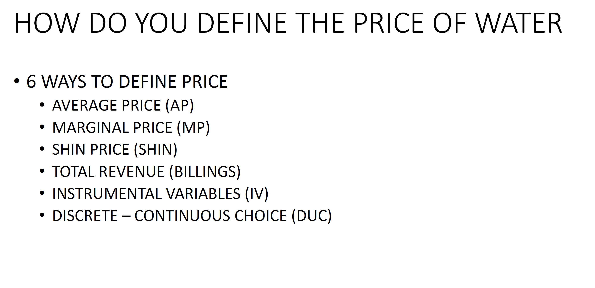
Reason #1
University of Utah Professors Use a Misleading and Inconsistent Price of Water
Source: Professor Gail Blattenberger, Presentation to the Executive Water Finance Board, May 22, 2018.

Slide 101
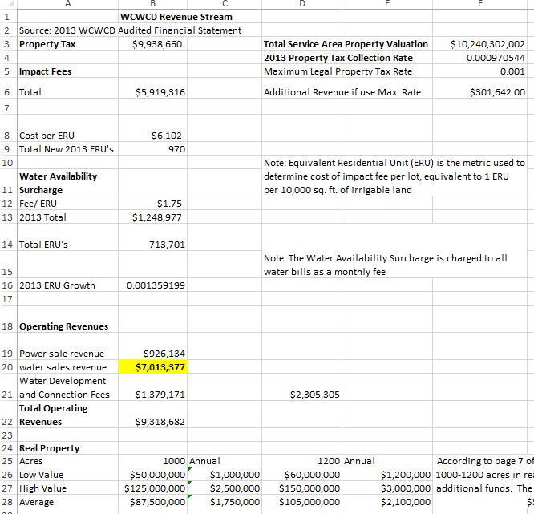
University of Utah researchers calculated the current price of water and the total quantity of water demanded, using “water sales revenue” of approximately $7.0 million from the annual financial statements of the Washington County Water Conservancy District

Slide 102
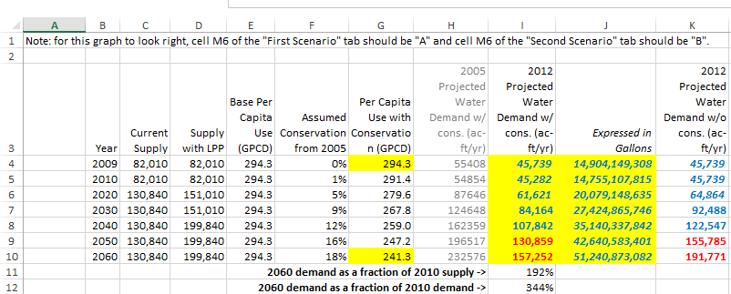
To estimate the quantity of water demanded, the university researchers start with a baseline consumption level of 294.3 gallons per capita per day. They apply a conservation factor of 18 percent by 2060, and then multiply this value by the projected population in Washington County. This results in an estimated water demand of 45,739 acre feet in 2010, escalating to 157,252 acre feet in 2060 (with conservation).
Total Number of Acre Feet of Water Demanded
(with conservation)
Estimated Per
Capita Water Use
(with conservation)
Total Number of Gallons of Water Demanded
Note: The conversion to gallons was done by us simply to express total water demanded in units that people are more accustomed to seeing (gallons versus acre feet).

Slide 103
Applying the researchers’ logic to 2015 values results in approximately 16.15 billion gallons of water demanded by the residents of Washington County.
Estimated Washington County Population |  | 155,000
Gallons of Water Demanded Per Capita Per Day (GPCD) |  | 285
Total Gallons of Water Consumed in Washington County Each Day (Population * GPCD) |  | 44.2M
Total Gallons of Water Consumed in Washington County Each Year (Population * GPCD *365 Days Per Year) |  | 16.15B
Midpoint of 2010 and
2020 Estimates
Total Quantity of Water Demanded

Slide 104
Consumers typically pay for water based on a price per 1,000 gallons consumed. The professors suggest this unit price is approximately 45 cents per 1,000 gallons
Total Water Rate Revenue:
$7,245,479
Total Water Demanded, in Gallons:
16,150,521,825
Gallons Demanded / 1,000:
16,150,522
Price Per 1,000 Gallons Consumed:
$0.45

Slide 105

Reason #1
University of Utah Professors Use a Misleading and Inconsistent Price of Water

Slide 106
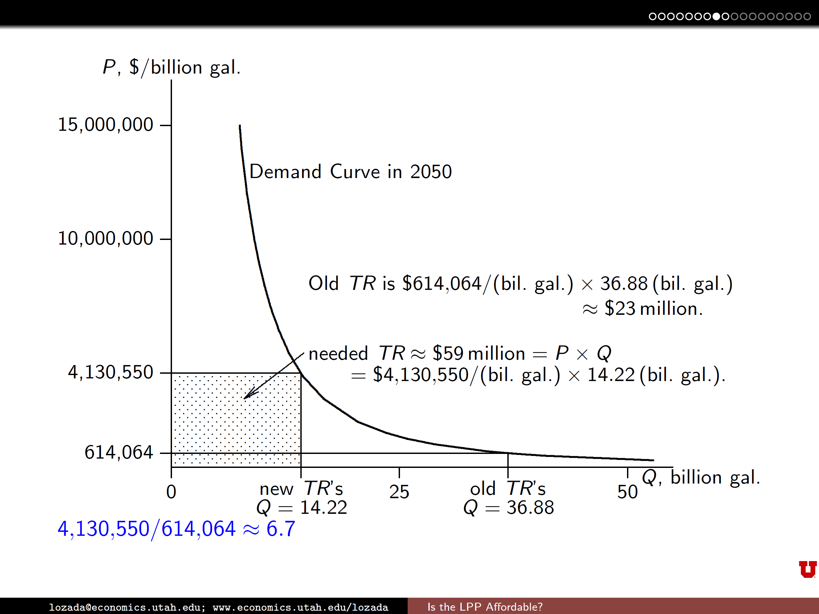
Analysis assumes in 36.88B gallons are consumed
Analysis assumes $23M in revenue is generated
Translates into a total revenue price point based on $0.62 per 1,000 gallons
$614,064 / 1,000,000,000 gallons = $0.000641 / gallon
X 1,000 gallons =
$0.61 per 1,000 gallons

Slide 107
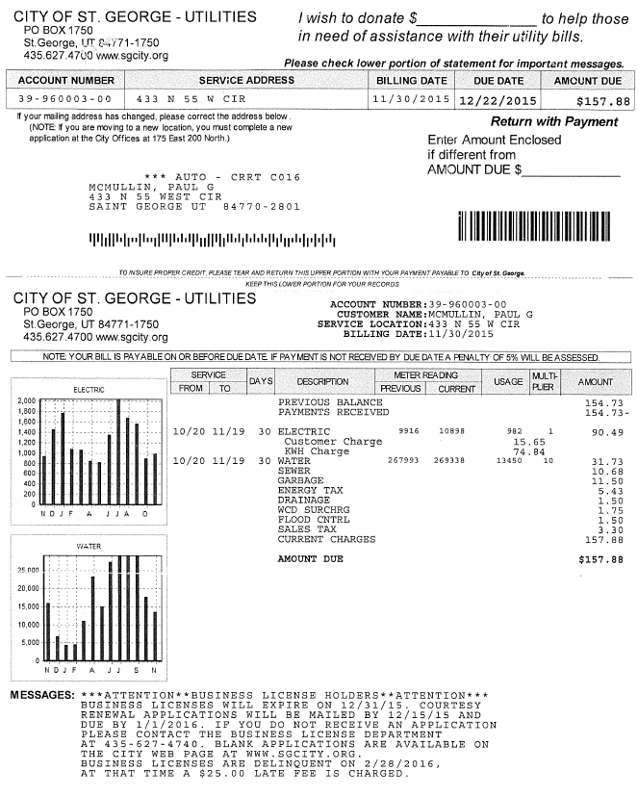
Below is a typical water bill for a single family household in St. George, Utah
Residents of Washington County pay significantly more than 1 dollar, 61 cents, or 45 cents per 1,000 gallons of water consumed.
Total Water Consumed: 13,450
Note: This is consistent with average consumption in the region.

Slide 108
Below is a typical water bill for a single family household in St. George, Utah
Residents of Washington County pay significantly more than 1 dollar, 61 cents, or 45 cents per 1,000 gallons of water consumed.
Total Water Cost: $31.73

Slide 109
Below is a typical water bill for a single family household in St. George, Utah
Residents of Washington County pay significantly more than 1 dollar, 61 cents, or 45 cents per 1,000 gallons of water consumed.
Water Cost Per 1,000 Gallons Consumed: $2.36
Note: This is simply the $31.73 divided by total consumption of 13,450 divided by 1,000.

Slide 110
Reason #2
Price of Water ($/1,000 Gallons)
Flawed Assumptions Lead to Flawed Calculations
Gallons of Water Demanded in Washington County (in Billions)
Notes:
8

Slide 111
According to the university researchers’ analysis, Washington County is currently on the point of this curve where $7.2 million in water revenues are generated from the sale of 16.2 billion gallons of water at $0.45 per gallon.
Price of Water ($/1,000 Gallons)
$0.45 Per 1,000 Gallons
Total Water Sales Revenue: $7.2M
16.2B Gallons
of Water Demanded
(285 GPCD)
Gallons of Water Demanded in Washington County (in Billions)
Notes:
8

Slide 112
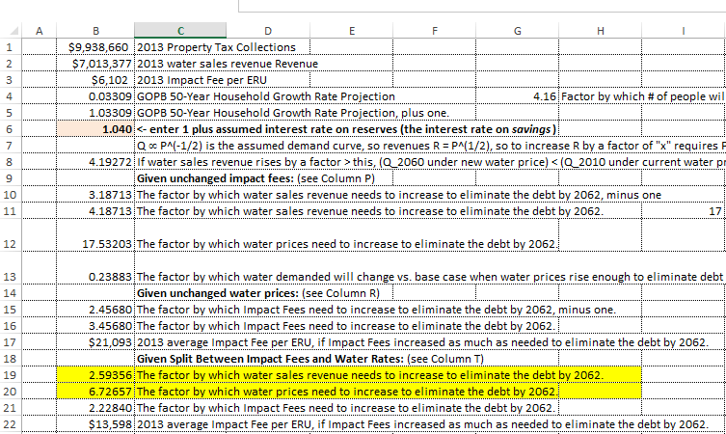
The researchers suggest that water sales revenue will need to increase by a factor of 2.6x to pay for the Lake Powell Pipeline and that, because higher prices will lead to decreased demand for water, prices will need to increase by a factor of 6.7x to generate a sufficient amount of revenue.
Note: This review is based on a single scenario, which assumes the Lake Powell Pipeline is repaid over 50 years and costs are allocated equally between water rates and impact fees. In other scenarios, where 100 percent of the cost is borne by water rates or the repayment period is shortened, the magnitude of the professors’ errors are magnified.

Slide 113
Under the researchers’ assumptions, water rates increase by a factor of 6.7x, or from the assumed $0.45 per to $3.02 per 1,000 gallons. This, in turn, reduces total water demanded from 16.2 billion to 6.2 billion, resulting in a 61.5-percent decrease in per capita water use in Washington County. Because this reduction in water use would be impractical to achieve, the professors conclude that the Lake Powell Pipeline is infeasible.
Price of Water ($/1,000 Gallons)
$3.02 Per 1,000 Gallons
Total Water Sales Revenue: $18.7M
2.6x
Increase
$0.45 Per 1,000 Gallons
Total Water Sales Revenue: $7.2M
6.2B Gallons
of Water Demanded
(110 GPCD)
61.5%
Decrease
16.2B Gallons
of Water Demanded
(285 GPCD)
Gallons of Water Demanded in Washington County (in Billions)
Notes:
8

Slide 114
When the actual price of water is applied, the price elasticity curve shifts to the right, reflecting higher quantities demanded at all price points.
Price of Water ($/1,000 Gallons)
Gallons of Water Demanded in Washington County (in Billions)

Slide 115
Using the correct price of water in Washington County, the total water demanded, as estimated by the professors, generates approximately $38.5 million per year as compared to $7.2 million.
Price of Water ($/1,000 Gallons)
$2.38 Per 1,000 Gallons
Total Water Sales Revenue: $38.5M
Total Water Sales Revenue: $7.2M
$0.45 Per 1,000 Gallons
16.2B Gallons
of Water Demanded
(285 GPCD)
Gallons of Water Demanded in Washington County (in Billions)

Slide 116
Reason #2
Flawed Assumptions Lead to Flawed Calculations

Slide 117
Reason #2
Flawed Assumptions Lead to Flawed Calculations

Slide 118
Reason #2
Flawed Assumptions Lead to Flawed Calculations

Slide 119
Flawed assumptions lead to flawed conclusions…
Analysis assumes in 36.88B gallons are consumed
Analysis assumes $23M in revenue is generated
Translates into a total revenue price point based on $0.62 per 1,000 gallons

Slide 120
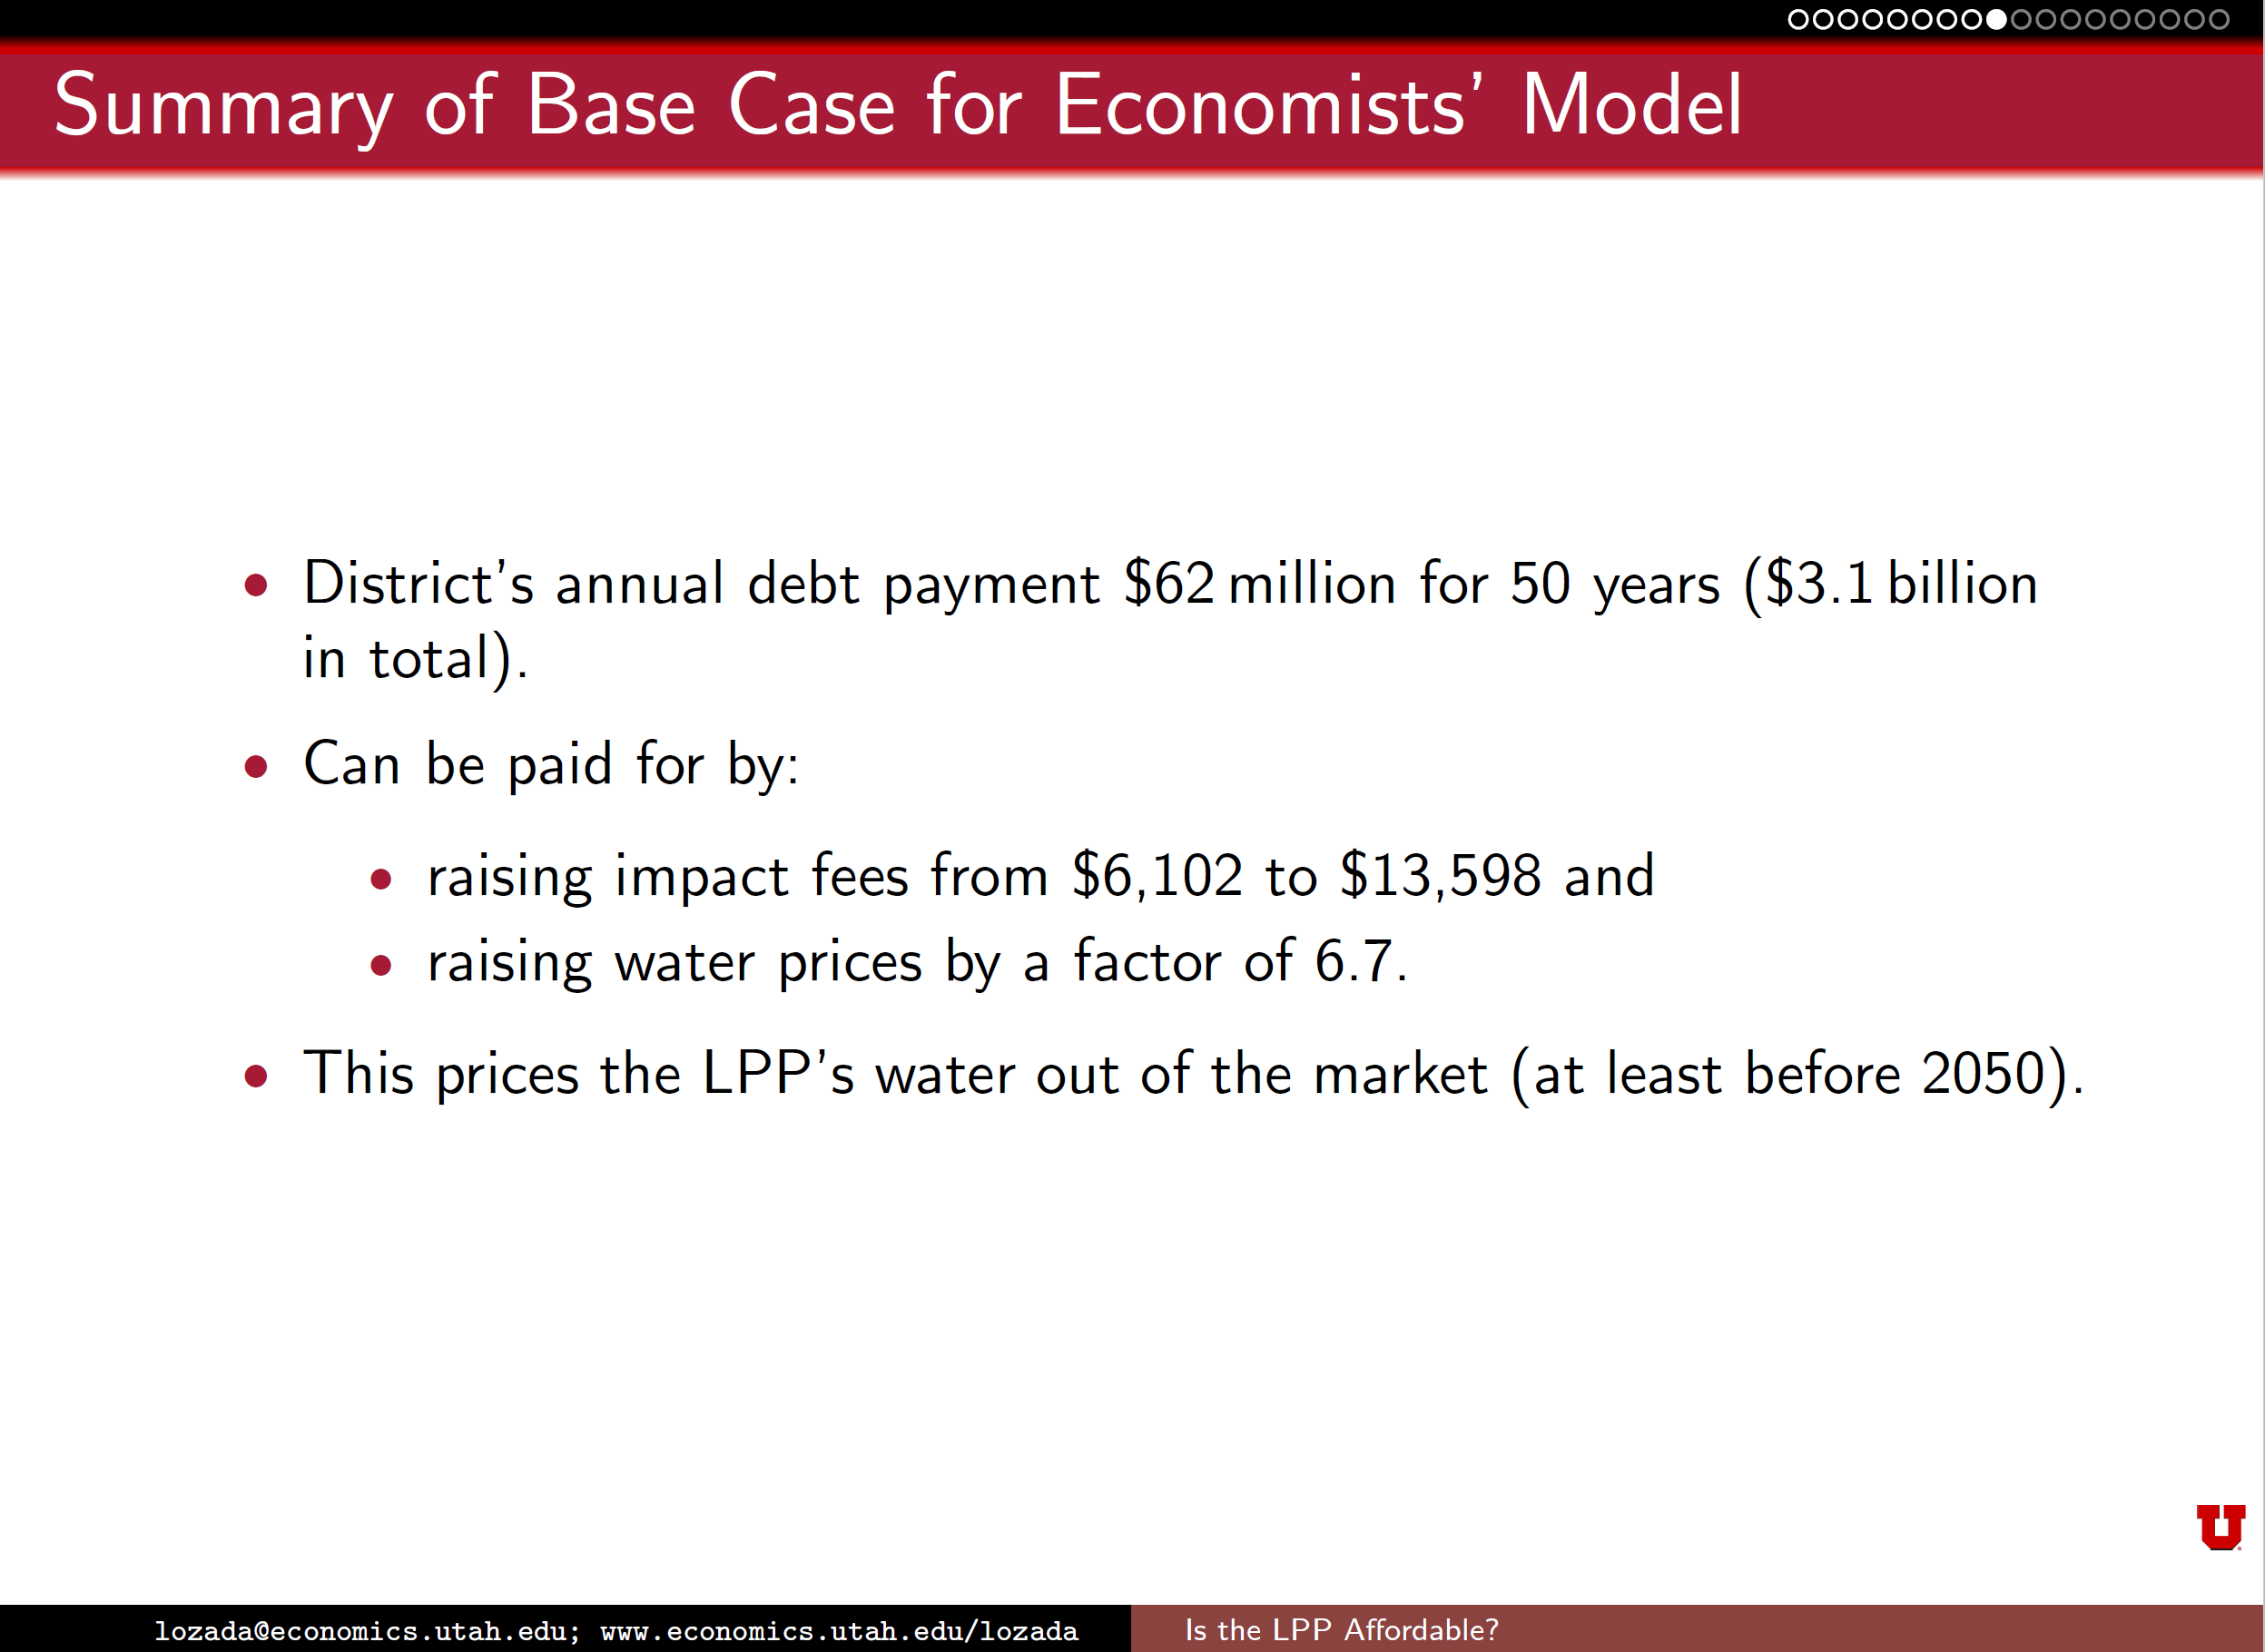
Flawed assumptions lead to flawed conclusions…
Analysis assumes in 36.88B gallons are consumed
Analysis assumes $23M in revenue is generated
Translates into a total revenue price point based on $0.62 per 1,000 gallons

Slide 121
Price Elasticity of Demand Considered in Supply-Demand Estimates
ԑ = -0.5037
at every point on the demand curve

Slide 122
Reason #3
Assumes Ample Water Exists
“Washington County has ample water to serve future populations without participation in the Lake Powell Pipeline."
Assumes an Accelerated Timeline for the LPP Project
Model assumes that the residents of Washington County begin paying for the cost of the Lake Powell Pipeline in 2015, the year before the analysis was completed
Ignores the Lake Powell Pipeline Development Act
Assumes a straight-line amortization (mortgage) approach to repayment of the pipeline
University of Utah Professors Rely on Unrealistic Assumption

Slide 123
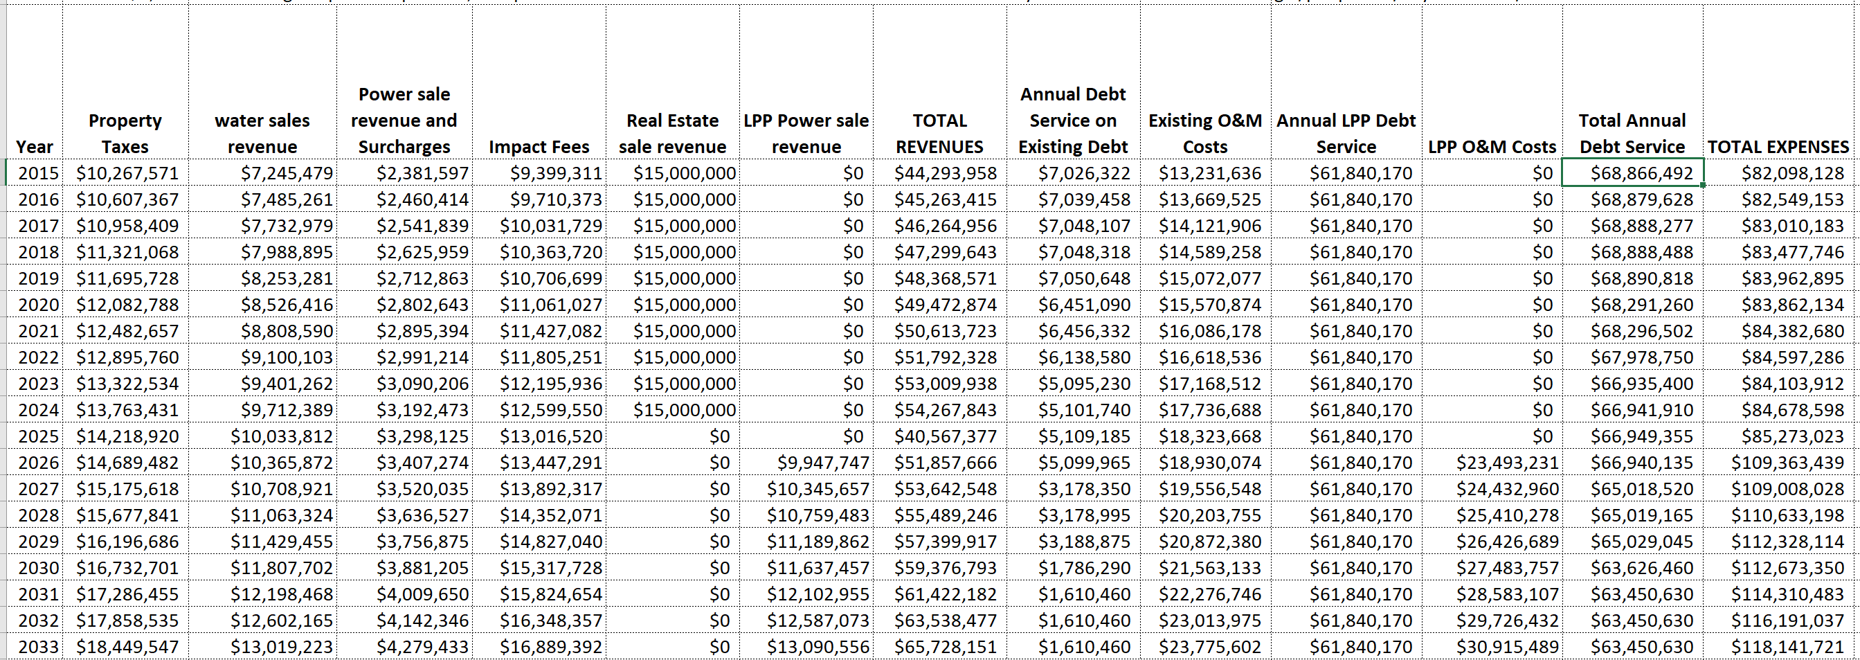
University of Utah professors assume the cost of the pipeline is incurred more than a decade before the project would come on line

Slide 124
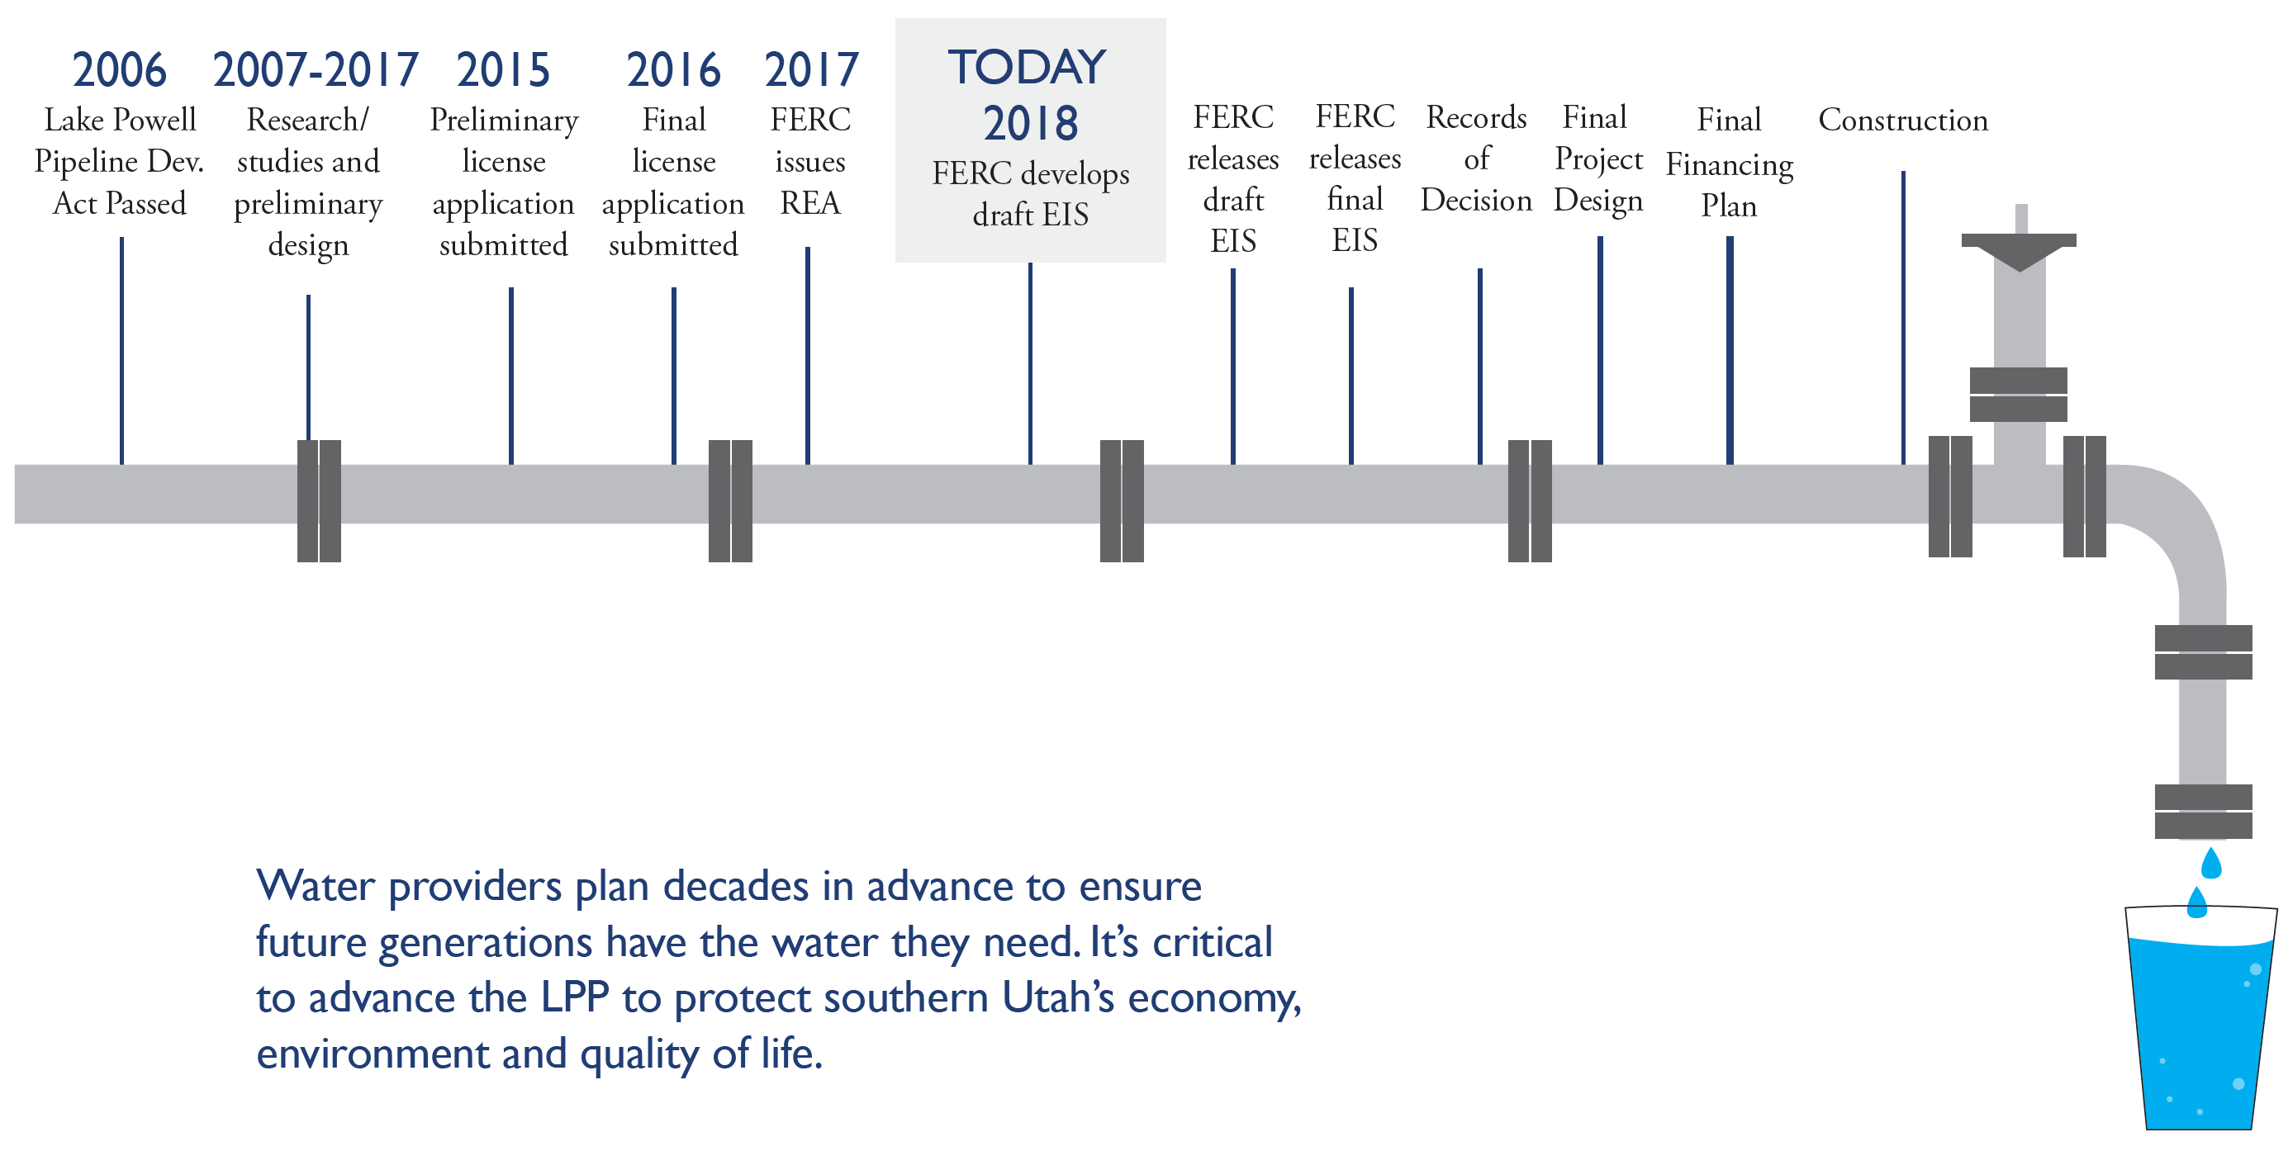
The Lake Powell Pipeline project is currently under review by federal agencies and is expected to be completed in the late 2020s.

Slide 125
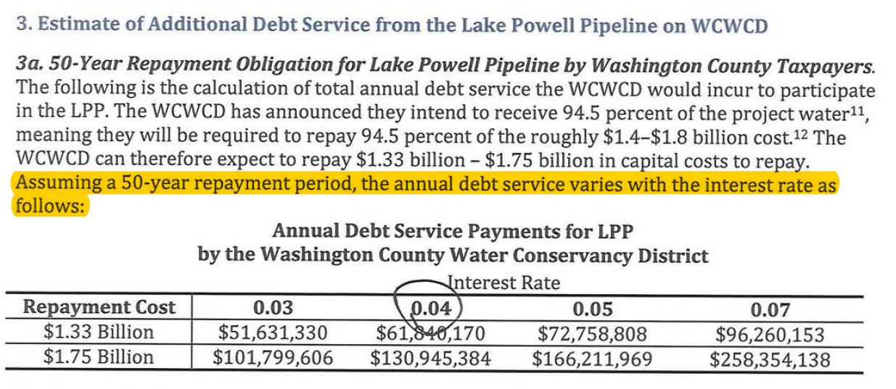
Reason #4
Calculation
Errors Limit the Utility of the Provided Analysis
$1.75 Billion Amortized Over 50 Year at a 4 Percent Interest Rates Equals, $81.5M, not $130.9M.

Slide 127
Additional Slides

Slide 128
Quantifying the Fiscal Implications

